Slide 1
BIG DATA AND CLOUD PLATFORMS
MODULE 2

Slide 2
whoami
Matteo Francia, Ph.D.
Email: m.francia@unibo.it
Assistant Professor (junior) @ DISI --- UniBO
Research topics
Big data / database
Precision agriculture and spatio-temporal analytics
BIG (Business Intelligence Group)
https://big.csr.unibo.it/

Slide 3
Table of Contents and Exam
Handling data pipelines in the Cloud
Introduction to data platforms: shifting from databases to well-integrated data ecosystems
Definition of cloud and taxonomy of cloud services
Introduction to the most relevant Cloud Platforms
Introduction to the billing models that lay behind Cloud Computing services
Cluster migration: on-premises vs on-cloud
Real case studies
Seminars by companies working with cloud and big data platforms
Connecting the dots
Information systems, BI, data mining, big data, and machine learning
… all these points will be part of the oral examination! :)

Slide 4
Table of Contents and Exam
Questions on all (theoretical and practical) aspects of the course
A single session with both teachers
Exam covers both modules
Seminars are included
Interaction during the lectures/labs is considered in the final evaluation
According to the University's regulation
Exams must be in presence
Cannot refuse a grade more than once
No scheduled dates, just come when you are ready
Send an email to enrico.gallinucci@unibo.it to book an appointment
At least a week in advance
Be prepared: you have to wait 1 month before trying again (in any case)

Slide 5
Dictionary
Analysis is a detailed examination of something in order to understand its nature or determine its essential features.
Data analysis is the process of compiling, processing, and analyzing data so that you can use it to make decisions.
Analytics is the systematic analysis of data.
Data analytics is the specific analytical process being applied.
Big data is an industry term that has changed in recent years. Big data solutions are often part of data analysis solutions.
Curation is the action or process of selecting, organizing, and looking after the items in a collection. Data integrity is the maintenance and assurance of the accuracy and consistency of data over its entire lifecycle. Data veracity is the degree to which data is accurate, precise, and trusted.

Slide 6
Set up
You (will) have an AWS Educate account
A coupon of 150$ to test AWS cloud services
The content of these slides refers to this repo
https://github.com/w4bo/bigdata-aws/
Options
Work on your pc: check the `README.md` to install the necessary software tools
Mainly: git, IntelliJ IDEA (Community Edition), docker, AWS CLI, AWS SAM CLI
Download a pre-configured (VMware) VM with the installed software
Slides are available on "Virtuale"
https://aws.amazon.com/education/awseducate/

Slide 7
Set up
Download a pre-configured (VMware) VM with the installed software
Connect to a PC-lab using Guacamole (click here https://csi-rlab.campusfc.unibo.it/)
Enter your credentials
Choose `LabCEZ`
Click on the proper lab
Once logged in, download the VM from http://big.csr.unibo.it/downloads/ubuntu-64-bit.zip
Unzip the content and launch `VMware Workstation Pro` (from the desktop)
`File` > `Open...` > `path/to/the/unzipped/vm/*.vmx` file
Launch the VM (user: `bigdata`, pwd: `bigdata`)

Slide 8
So far
You have acquainted/practiced with on-premises solutions
You were given a working hardware cluster
... to deploy software applications on Hadoop-based stack
In the perspective of digital transformation¹, let us guess
How would you start from scratch?
How much time would it take?
¹ The process of using digital technologies to create new — or modify existing — business processes, culture, and customer experiences to meet changing business and market requirements

Slide 9
So far
No easy answers
Big-data (distributed) architectures require a lot of skills
Configuration: how do I set up dozens of new machines?
Networking: how do I cable dozens of machines?
Management: how do I replace a broken disk?
Upgrade: how do I extend the cluster with new services/machines?
(energy and cooling, software licenses, insurance...)
https://aws.amazon.com/compliance/data-center/data-centers/

Slide 10
So far
Two sides of the same coin, and your profile is a perfect? fit
Technological perspective
How do we configure a distributed environment?
How do we set up/integrate/control independent services?
How do we orchestrate data flows?
Business perspective
Can we afford to spend resources on tasks that are not mission oriented?
No free lunch, each choice has cost/benefit
How much time does it take to master a technology?
How many people do I need?
… but first, which are our data needs?

Slide 11
So far
Can we afford to spend resources on tasks that are not mission oriented?
Mission: a statement used by a company to explain its purpose(s)

Slide 12

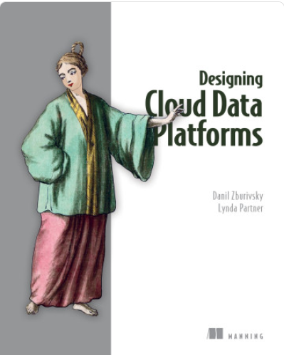
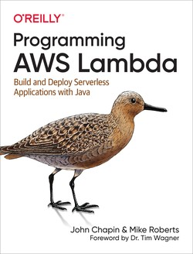


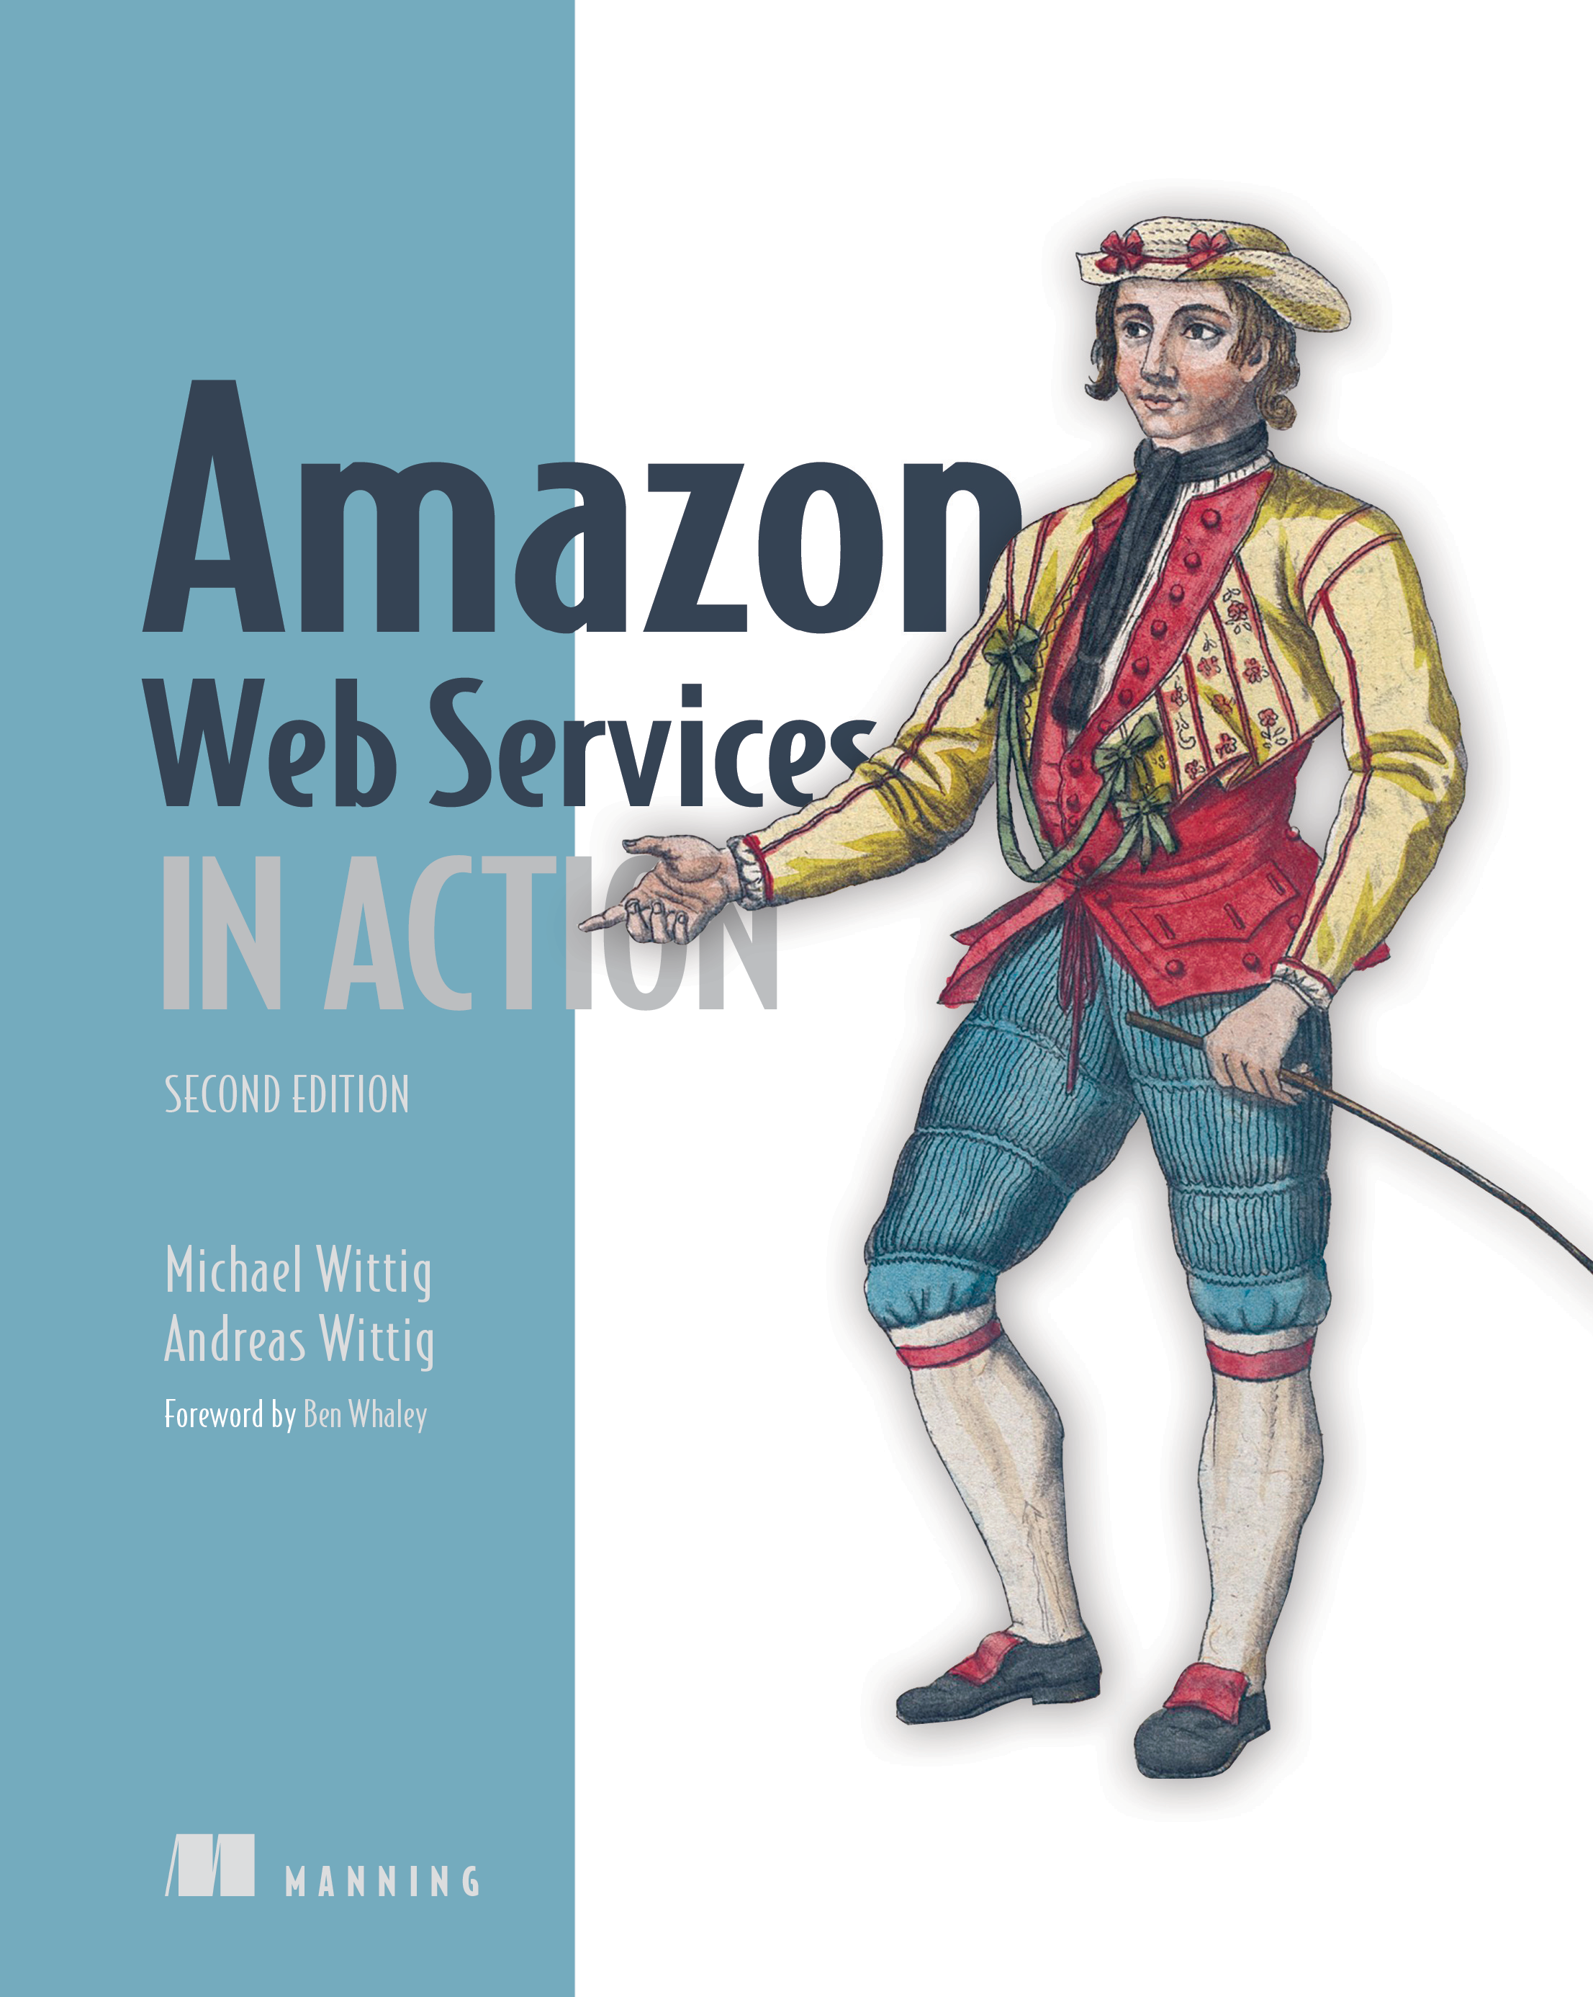
Teaching material
Books
Web content
Generic
Specific

Slide 13
Teaching material
You will find all you need in these slides
However, keeping up the pace with data platforms and cloud is hard
There is a rapid development of technologies, and not all of them will survive
Books are easily outdated with respect to cutting-edge services and technologies
Research papers (often) describe solutions that are not commercial yet
(IRL) You will need to deal with a lot of (bad) documentation, online articles, etc.
Rule of thumb
Understand the general concepts
Do not be afraid of change

Slide 14
BIG DATA AND CLOUD PLATFORMS
From databases to data platforms

Slide 15
How did we get here?
Data-Driven Innovation
Use of data and analytics to foster new products, processes and markets
Drive discovery and execution of innovation, achieving new services with a business value
Analytics
A catch-all term for different business intelligence (BI)- and application-related initiatives
E.g., of analyzing information from a particular domain
E.g., applying BI capabilities to a specific content area (e.g., sales, service, supply chain)
Advanced Analytics
(Semi-)Autonomous examination of data to discover deeper insights, make predictions, or generate recommendations (e.g., through data/text mining and machine learning)
Augmented Analytics
Use of technologies such as machine learning and AI to assist with data preparation, insight generation and insight explanation to augment how people explore and analyze data
https://www.gartner.com/en/information-technology/glossary (accessed 2022-08-01)

Slide 16
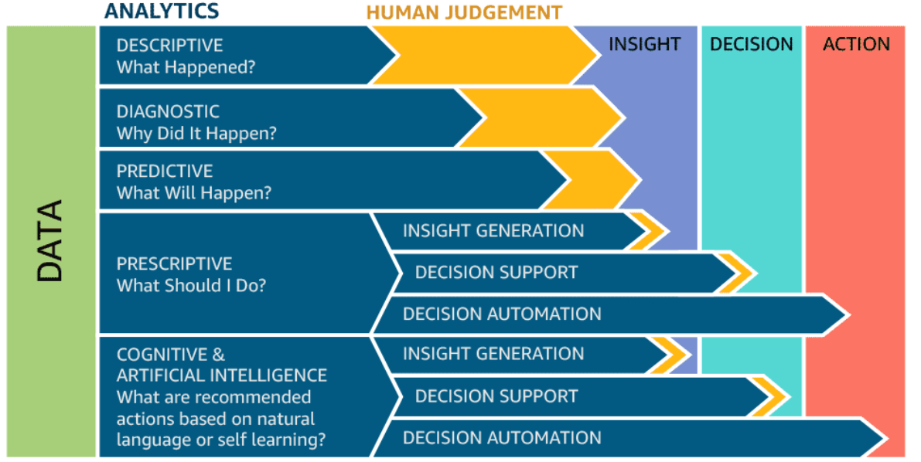
How did we get here?

Slide 17
Data platform
Companies are collecting tons of data to enable advanced analytics
Raw data is difficult to obtain, interpret, and maintain
Data is more and more heterogeneous
There is need for curating data to make it consumable
Where are we collecting/processing data?
Getting value from data is not (only) a matter of storage
Need integrated and multilevel analytical skills and techniques

Slide 18
Data platform
Getting value from data is not (only) a matter of storage
Any example?
“It is a capital mistake to theorize before one has data. Insensibly, one begins to twist the facts to suit theories, instead of theories to suit facts.”
– Sherlock Holmes

Slide 19

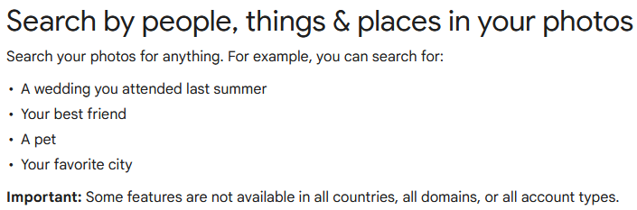
Case study: photo gallery

Slide 20
Data platform
Database
"A database is a structured and persistent collection of information about some aspect of the real world organized and stored in a way that facilitates efficient retrieval and modification. The structure of a database is determined by an abstract data model. Primarily, it is this structure that differentiates a database from a data file."
Relational
fk1 | pk | fk2
pk
pk
Özsu M.T. (2018) Database. In: Encyclopedia of Database Systems. Springer, New York, NY. https://doi.org/10.1007/978-1-4614-8265-9_80734

Slide 21
Data platform
Data Warehouse
"A collection of data that supports decision-making processes. It provides the following features: subject-oriented, integrated and consistent, not volatile."
Relational
DWH
(ROLAP)
From DB to DWH
ETL
Operational (relational) databases
Matteo Golfarelli and Stefano Rizzi. Data warehouse design: Modern principles and methodologies. McGraw-Hill, Inc., 2009.

Slide 22
Data platform: OLTP vs OLAP

Slide 23
Data platform: OLTP vs OLAP
Characteristic | OLTP | OLAP
Nature | Constant transactions (queries/updates) | Periodic large updates, complex queries
Examples | Accounting database, online retail transactions | Reporting, decision support
Type | Operational data | Consolidated data
Data retention | Short-term (2-6 months) | Long-term (2-5 years)
Storage | Gigabytes (GB) | Terabytes (TB) / Petabytes (PB)
Users | Many | Few
Protection | Robust, constant data protection and fault tolerance | Periodic protection

Slide 24
Data platform
From RELATIONAL to SCHEMALESS
Big data Vs?
Relational
NoSQL (Non relational)
DWH
(ROLAP)
[{
"_id": 1,
“firstname": “Alice”
}, {
"_id": 2,
“name": “Bob”
}]
Document
[
(“k1”, “v1),
(“k2”, “v2)
]
ETL
Key-value
Graph
Operational (relational) databases

Slide 25
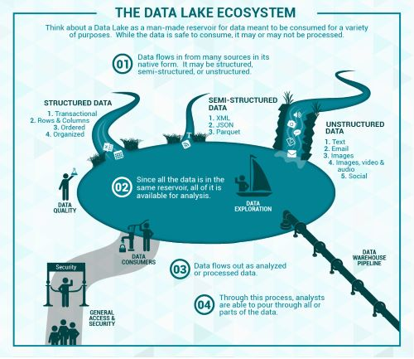
Data platform
Data lake
Couto et al.: “A DL is a central repository system for storage, processing, and analysis of raw data, in which the data is kept in its original format and is processed to be queried only when needed. It can store a varied amount of formats in big data ecosystems, from unstructured, semi-structured, to structured data sources”
Couto, Julia, et al. "A Mapping Study about Data Lakes: An Improved Definition and Possible Architectures." SEKE. 2019. https://dunnsolutions.com/business-analytics/big-data-analytics/data-lake-consulting

Slide 26

Data platform
Relational
NoSQL (Non relational)
Storage of Raw Data
DWH
(ROLAP)
[{
"_id": 1,
“firstname": “Alice”
}, {
"_id": 2,
“name": “Bob”
}]
Document
[
(“k1”, “v1),
(“k2”, “v2)
]
ETL
Key-value
Raw
Graph
Operational (relational) databases
Data Lake

Slide 27
Data platform: DWH vs Data Lake

Slide 28
Data platform: DWH vs Data Lake
Characteristics | Data warehouse | Data lake
Data | Relational | Non-relational and relational
Schema | Designed prior to implementation (schema-on-write) | Written at the time of analysis (schema-on-read)
Price/ performance | Fastest query results using higher cost storage | Query results getting faster using low-cost storage
Data quality | Highly curated data that serves as the central version of the truth | Any data, which may or may not be curated (e.g., raw data)
Users | Business analysts | Data scientists, data developers, and business analysts (using curated data)
Analytics | Batch reporting, BI, and visualizations | Machine learning, predictive analytics, data discovery, and profiling.

Slide 29
Data platform: DWH
Reduce stress on operational systems
Integrate data sources
No IT involvement to create reports
One version of the truth
Make better business decisions

Slide 30
Data platform
Data lakes have increasingly taken the role of data hubs
Eliminate up-front costs of ingestion and ETL since data are stored in original format
Once in DL, data are available for analysis by everyone in the organization
Drawing a sharp line been storage/computation/analysis is hard
Is a database just storage?
What about SQL/OLAP?
Blurring of the architectural borderlines
DL is often replaced by “data platform” or “data ecosystem”
Encompass systems supporting data-intensive storage, computation, analysis

Slide 31
Data platform
Data platform
An integrated set of technologies that collectively meets an organization’s end-to-end data needs such as acquisition, storage, preparation, delivery, and governance, as well as a security layer for users and applications
Rationale: relieve users from complexity of administration and provision
Not only technological skills, but also privacy, access control, etc.
Users should only focus on functional aspects
Are we done? No!
Lacking smart support to govern the complexity of data and transformations
Data transformations must be governed to prevent DP turning into a swamp
Amplified in data science, with data scientists prevailing data architects
Leverage descriptive metadata and maintenance to keep control over data

Slide 32
Managing data platforms
Which functionalities for (automated) data management can you think about?

Slide 33
Managing data platforms
Data provenance
Compression
Data profiling
Entity resolution
Data versioning
…

Slide 34
Data provenance
Provenance (also referred to as lineage, pedigree, parentage, genealogy)
The description of the origins of data and the process by which it arrived at the database
Not only data products (e.g., tables, files), but also the processes that created them
Examples of use cases
Business domain. Users traditionally work with an organized data schema, where the structure and semantics of the data in use is shared across the corporation or even B2B. Yet, a large proportion of businesses deal with bad quality data. Sources of bad data need to be identified and corrected to avoid costly errors in business forecasting.
Scientific/research domain. Data used in the scientific field can be ad hoc and driven by individual researchers or small communities. The scientific field is moving towards more collaborative research and organizational boundaries are disappearing. Sharing data and metadata across organizations is essential, leading to a convergence on common schemes to ensure compatibility. Issues of trust, quality, and copyright of data are significant when using third-party data in such a loosely connected network.
Simmhan, Yogesh L., Beth Plale, and Dennis Gannon. "A survey of data provenance techniques." Computer Science Department, Indiana University, Bloomington IN 47405 (2005): 69.

Slide 35

Data provenance
Astronomers are creating an international Virtual Observatory
A federation of all the world significant astronomical data resources coupled with provision of the computational resources needed to exploit the data scientifically
Astronomy changed from being an individualistic to a collective enterprise
Telescope time is devoted/allocated to systematic sky surveys and analysis is performed using data from the archives
Astronomers are increasingly relying on data that they did not take themselves
Raw data bear many instrumental signatures that must be removed in the process of generating data products
Mann, Bob. "Some data derivation and provenance issues in astronomy." Workshop on Data Derivation and Provenance, Chicago. 2002. https://www.esa.int/Science_Exploration/Space_Science/Webb/Webb_inspects_the_heart_of_the_Phantom_Galaxy (accessed 2022-08-01)

Slide 36
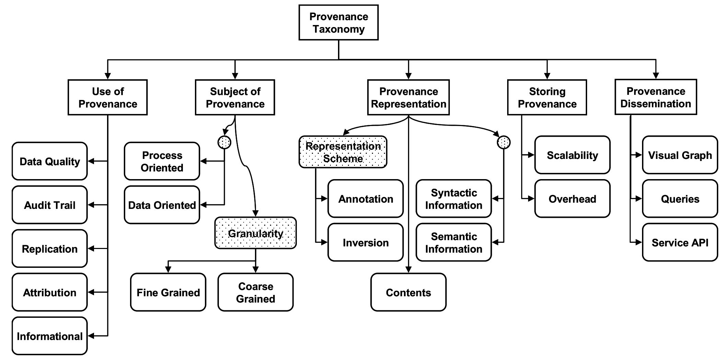
Data provenance
Simmhan, Yogesh L., Beth Plale, and Dennis Gannon. "A survey of data provenance techniques." Computer Science Department, Indiana University, Bloomington IN 47405 (2005): 69.

Slide 37
Data provenance
Granularity
Fine-grained (instance level): tracking data items (e.g., a tuple in a dataset) transformations
Coarse-grained (schema-level): tracking dataset transformations
Queries
Where provenance: given some output, which inputs did the output come from?
How provenance: given some output, how were the inputs manipulated?
Why provenance: given some output, why was data generated?
E.g., in the form of a proof tree that locates source data items contributing to its creation
Simmhan, Yogesh L., Beth Plale, and Dennis Gannon. "A survey of data provenance techniques." Computer Science Department, Indiana University, Bloomington IN 47405 (2005): 69. Ikeda, Robert, and Jennifer Widom. Data lineage: A survey. Stanford InfoLab, 2009.

Slide 38
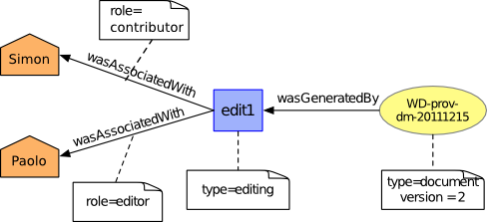
Data provenance
Data provenance, an example of data management
Metadata pertaining to the history of a data item
Pipeline including the origin of objects and operations they are subjected to
We have a standard: https://www.w3.org/TR/prov-dm/
https://www.w3.org/TR/prov-dm/

Slide 39
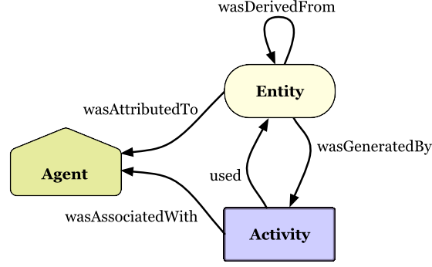
Data provenance
Entity
Physical/conceptual things
Activity
Dynamic aspects of the world, such as actions
How entities come into existence, often making use of previously existing entities
Agent
A person, a piece of software
Takes a role in an activity such that the agent can be assigned some degree of responsibility for the activity taking place
https://www.w3.org/TR/2013/NOTE-prov-primer-20130430/

Slide 40
Data provenance
Use cases for data provenance
Accountability and auditing
Data quality
Monitoring of the quality (e.g., accuracy) of the objects produced
Notify when a transformation pipeline is not behaving as expected
Debugging
Inferring the cause of pipeline failures is challenging
Store inputs of each operation with versions and environmental settings (RAM, CPUs, etc.)
And so on...

Slide 41
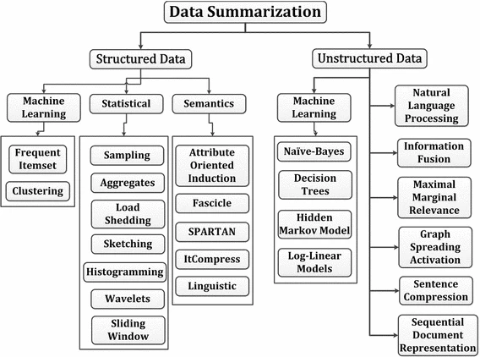
Compression
Summarization / compression
Present a concise representation of a dataset in a comprehensible and informative manner
Ahmed, Mohiuddin. "Data summarization: a survey." Knowledge and Information Systems 58.2 (2019): 249-273.

Slide 42
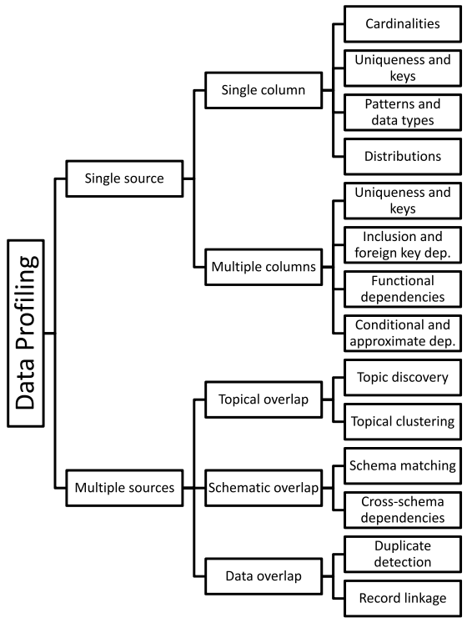
Data profiling
Data profiling
A broad range of methods to efficiently analyze a given data set
E.g., in a relational scenario, tables of a relational database are scanned to derive metadata, such as data types and value patterns, completeness and uniqueness of columns, keys and foreign keys, and occasionally functional dependencies and association rules
Naumann, Felix. "Data profiling revisited." ACM SIGMOD Record 42.4 (2014): 40-49.

Slide 43
Data profiling
Use cases
Query optimization
Performed by DBMS to support query optimization with statistics about tables and columns
Profiling results can be used to estimate the selectivity of operators and the cost of a query plan
Data cleansing (typical use case is profiling data)
Prepare a cleansing process by revealing errors (e.g., in formatting), missing values or outliers
Data integration and analytics
Challenges?
Naumann, Felix. "Data profiling revisited." ACM SIGMOD Record 42.4 (2014): 40-49.

Slide 44
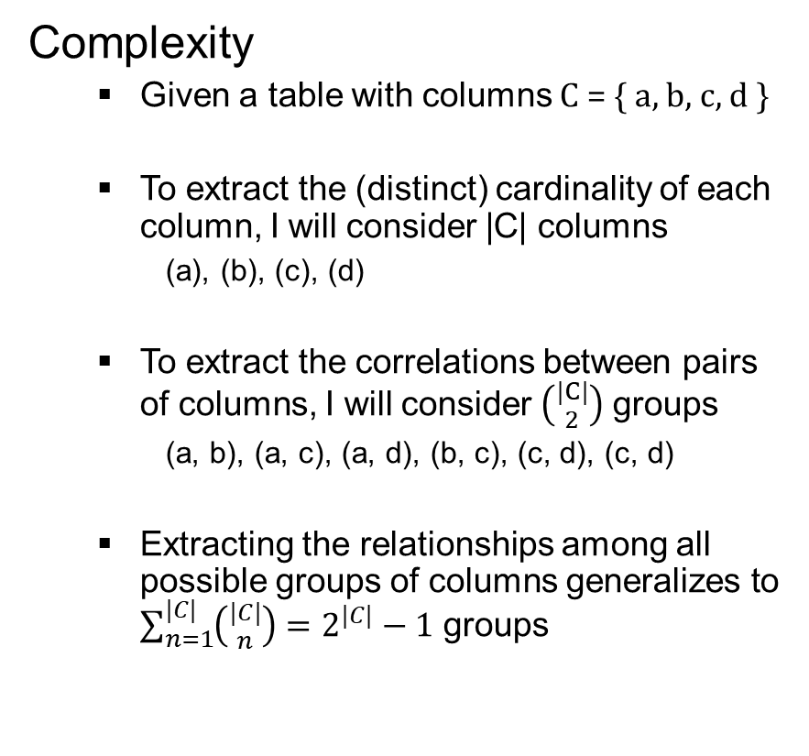
Data profiling
a | b | c | d
1 | 1 | 2 | 2
1 | 2 | 1 | 4
Challenges
The results of data profiling are computationally complex to discover
E.g., discovering keys/dependencies usually involves some sorting step for each considered column
Verification of complex constraints on column combinations in a database
What is the complexity of this task?
Complexity
Given a table with columns C = { a, b, c, d }
To extract the (distinct) cardinality of each column, I will consider |C| columns
(a), (b), (c), (d)
To extract the correlations between pairs of columns, I will consider $\left({|C| \atop 2}\right)$ groups
(a, b), (a, c), (a, d), (b, c), (c, d), (c, d)
Extracting the relationships among all possible groups of columns generalizes to $\sum_{n=1}^{|C|}{\left({|C| \atop n}\right)}=2^{|C|}−1$ groups
Naumann, Felix. "Data profiling revisited." ACM SIGMOD Record 42.4 (2014): 40-49.

Slide 45
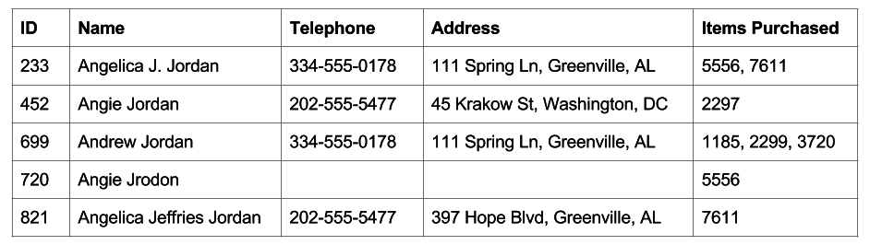
Entity resolution
Entity resolution
(also known as entity matching, linking)
Find records that refer to the same entity across different data sources (e.g., data files, books, websites, and databases)
Papadakis, George, et al. "Blocking and filtering techniques for entity resolution: A survey." ACM Computing Surveys (CSUR) 53.2 (2020): 1-42.

Slide 46

Data versioning
Version control
A class of systems responsible for managing changes to computer programs, documents, or data collections
Changes are identified by a number/letter code, termed the revision/version number
However, data pipelines are not only about code bult also about
Model Version control
Data Version Control
Model Parameter Tracking
Model Performance Comparison

Slide 47
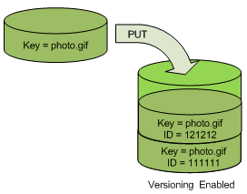
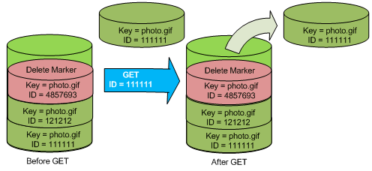
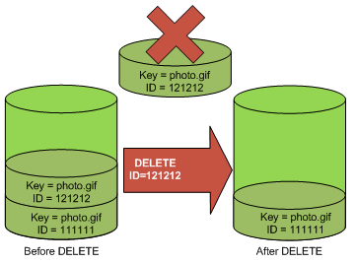
Data versioning
Support CRUD (Create, Read, Update, Delete) operations with versions
E.g., on AWS (PUT, GET, DELETE), what about update?
https://docs.aws.amazon.com/AmazonS3/latest/userguide/versioning-workflows.html (accessed 2022-08-01)

Slide 48

In action
Lab: California housing prices

Slide 49
Data platform
Are we done? No!
Metadata can become bigger than data themselves
We need meta meta-data (or models)...
... chasing our own tails
Data management is still a (research) issue in data platforms

Slide 50
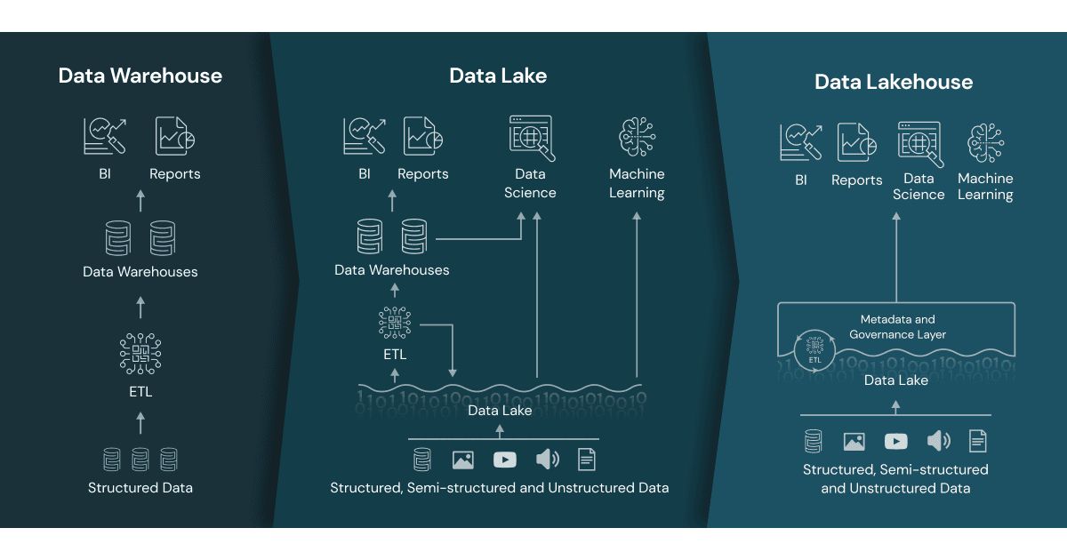
Data lakehouse
Data lakehouse
Data management architecture that combines the flexibility, cost-efficiency, and scale of data lakes with the data management and ACID transactions of data warehouses, enabling business intelligence (BI) and machine learning (ML) on all data
Vendor lock in
https://www.databricks.com/glossary/data-lakehouse

Slide 51
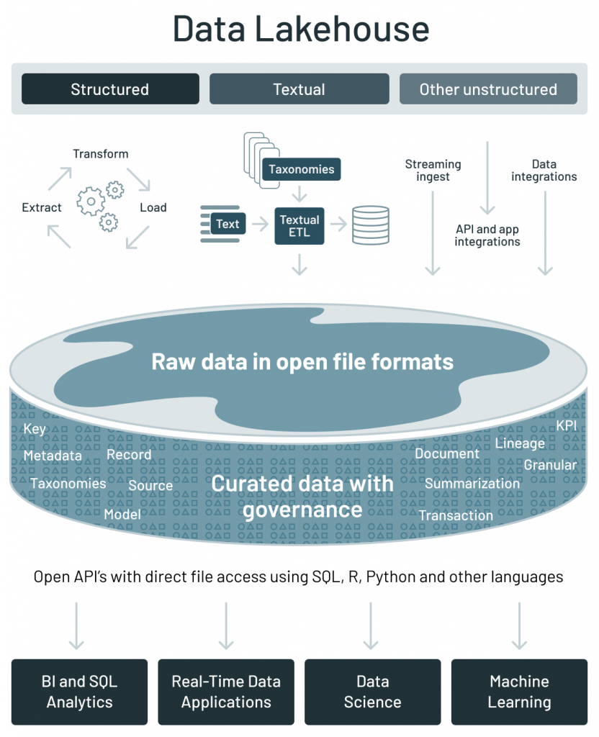
Data lakehouse
 | Data warehouse | Data lake | Data lakehouse
Data format | Closed, proprietary format | Open format (e.g., Parquet) | Open format
Types of data | Structured data, with limited support for semi-structured data | All types: Structured data, semi-structured data, textual data, unstructured (raw) data | All types: Structured data, semi-structured data, textual data, unstructured (raw) data
Data access | SQL-only, no direct access to file | Open APIs for direct access to files with SQL, R, Python and other languages | Open APIs for direct access to files with SQL, R, Python and other languages
Reliability | High quality, reliable data with ACID transactions | Low quality, data swamp | High quality, reliable data with ACID transactions
Governance and security | Fine-grained security and governance for row/columnar level for tables | Poor governance as security needs to be applied to files | Fine-grained security and governance for row/columnar level for tables
Performance | High | Low | High
Scalability | Scaling becomes exponentially more expensive | Scales to hold any amount of data at low cost, regardless of type | Scales to hold any amount of data at low cost, regardless of type
Use case support | Limited to BI, SQL applications and decision support | Limited to machine learning | One data architecture for BI, SQL and machine learning
Key technologies used to implement open source Data Lakehouses
Databricks’ Delta Lake
Apache Hudi
Apache Iceberg
https://databricks.com/blog/2021/05/19/evolution-to-the-data-lakehouse.html

Slide 52
Data fabric
Frictionless access and sharing of data in a distributed data environment
Enables a single and consistent data management framework, which allows seamless data access and processing by design across otherwise siloed storage
Leverages human and machine capabilities to access data in place or support its consolidation where appropriate
Continuously identifies and connects data from disparate applications to discover unique, business-relevant relationships between the available data points
It is a unified architecture with an integrated set of technologies and services
Designed to deliver integrated and enriched data – at the right time, in the right method, and to the right data consumer – in support of both operational and analytical workloads
Combines key data management technologies – such as data catalog, data governance, data integration, data pipelining, and data orchestration
Gartner, 2019 https://www.gartner.com/en/newsroom/press-releases/2019-02-18-gartner-identifies-top-10-data-and-analytics-technolo Gartner, 2021 https://www.gartner.com/smarterwithgartner/data-fabric-architecture-is-key-to-modernizing-data-management-and-integration K2View Whitepaper: What is a Data Fabric? The Complete Guide, 2021

Slide 53
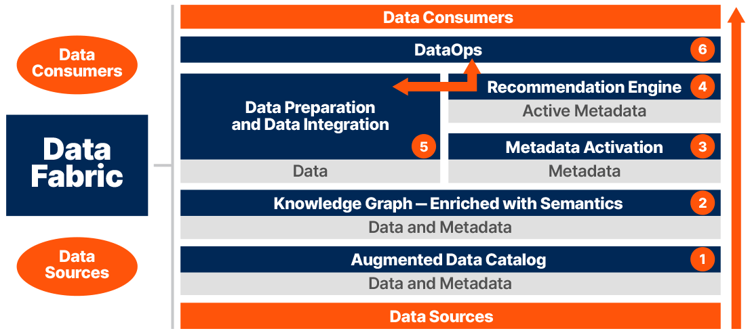
Data fabric
https://www.irion-edm.com/data-management-insights/gartner-data-summit-irion-representative-vendor-for-data-fabric-technology/

Slide 54
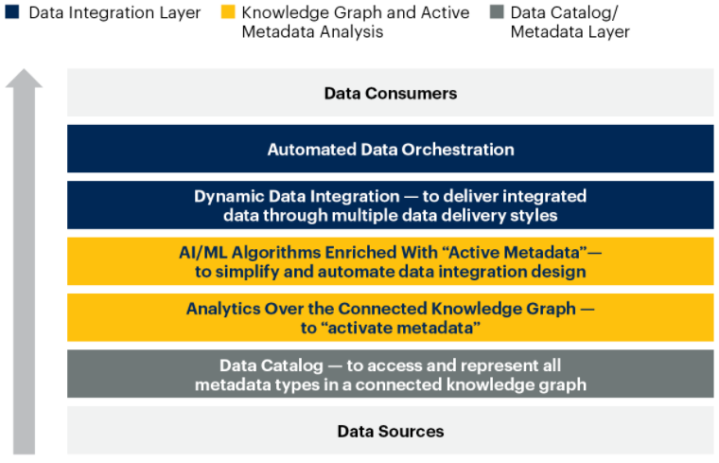
Data fabric
Gartner, 2021 https://www.gartner.com/smarterwithgartner/data-fabric-architecture-is-key-to-modernizing-data-management-and-integration

Slide 55
Data mesh
Distributed data architecture, under centralized governance and standardization for interoperability, enabled by a shared and harmonized self-serve data infrastructure
Domain-oriented decentralized data ownership
Decentralization and distribution of responsibility to people who are closest to the data, in order to support continuous change and scalability
Each domain exposes its own op/analytical APIs
Data as a product (quantum)
Products must be discoverable, addressable, trustworthy, self-describing, secure
Self-serve data infrastructure as a platform
High-level abstraction of infrastructure to provision and manage the lifecycle of data products
Federated computational governance
A governance model that embraces decentralization and domain self-sovereignty, interoperability through global standardization, a dynamic topology, automated execution of decisions by the platform
Zhamak Dehghani, 2019 https://martinfowler.com/articles/data-monolith-to-mesh.html Zhamak Dehghani, 2020 https://martinfowler.com/articles/data-mesh-principles.html
Notes:
https://www.youtube.com/watch?v=_bmYXWCxF_Q

Slide 56
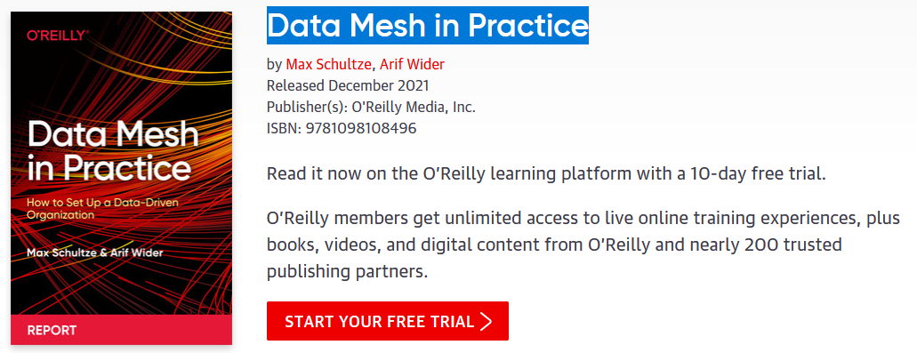
Data mesh

Slide 57
Data mesh vs data fabric
A data fabric and a data mesh both provide an architectural framework to access data across multiple technologies and platforms
Data fabric
Attempts to centralize and coordinate data management
Tackles the complexity of data and metadata in a smart way that works well together
Data mesh
Emphasis on decentralization and data domain autonomy
Focuses on organizational change; it is more about people and process
They are design concepts, not things
They are not mutually exclusive
They are architectural frameworks, not architectures
The frameworks must be adapted and customized to your needs, data, processes, and terminology
Gartner estimates 25% of data management vendors will provide a complete data fabric solution by 2024 – up from 5% today
Alex Woodie, 2021 https://www.datanami.com/2021/10/25/data-mesh-vs-data-fabric-understanding-the-differences/ Dave Wells, 2021 https://www.eckerson.com/articles/data-architecture-complex-vs-complicated

Slide 58
Example of data platform: Hadoop-based
A data platform on the Hadoop stack requires several tools
How many levels of complexity are hidden here?
How do you provision it?
Manual provisioning on-premises
Semi-automatic provisioning on-premises
Automatic provisioning in the cloud
Storage .
Resources .
Application .
GUI .
Messaging .
Orchestration .
Hue
Pig
Hive
Phoenix
Map Reduce
Batch
Spark
in mem
Flink
real-time
Others…
Impala
MPP
Kafka
Airflow
Zookeeper
HBASE
NoSQL
YARN
HDFS
NoSQL

Slide 59
On-premises manual provisioning
Hardly advisable, if not for small and local tests
Technical challenges
Installation: how do I set up a new machine?
Networking: how do I cable dozens of machines?
Management: how do I replace a broken disk?
Upgrade: how do I extend the cluster with new services/machines?
(energy and cooling, software licenses, insurance...)
Technological challenges
How do we configure a distributed environment?
How do we set up/integrate/control independent services?
How do we orchestrate data flows?
Business challenges
Can we afford to spend resources on tasks that are not mission oriented?
No free lunch, each choice has cost/benefit
How much time does it take to master a technology?
How many people do I need?

Slide 60










Example of data platform: MOSES
Example of a data platform (MOSES)
Functional architecture
Components of MOSES are in orange
Others are standard components in charge of producing/consuming, processing, storing, and visualizing data
The orchestrator (e.g., Oozie) manages (e.g., schedules) the data transformation processes
Orchestrator
Data Processes
MOSES
Proc. 1
Proc. 2
…
Proc. m
Metadata Extractor
Metadata Search
Engine
Provenance Manager
Storage
Trigger Engine
Other Storages
DFS
Custom components
Metadata
Process Interfaces
MOSES Interfaces
Web Interface
Other Interfaces
Workflow Administration
Metadata GUI
Francia, M., Gallinucci, E., Golfarelli, M., Rizzi, S. et al. (2021). Making data platforms smarter with MOSES. Future Generation Computer Systems, 125, 299-313.

Slide 61
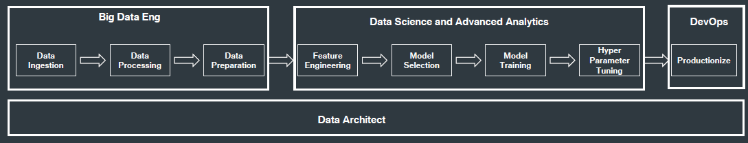
Data platform

Slide 62
Data platform: related job positions
Data platform engineer
Orchestrate the successful implementation of cloud technologies within the data infrastructure of their business
Solid understanding of impact database types and implementation
Responsible for purchasing decisions for cloud services and approval of data architectures
Data analyst
Analyze data systems, creating automated systems for retrieving data from the data platform
Cloud data analysts are more commonly members of the business user population
Data scientist
Analyze and interpret complex digital data
Work with new technologies (e.g., machine learning) to deepen the business' understanding and gain new insights
Data architect
Team members who understand all aspects of a data platform's architecture
Work closely with the data platform engineers to create data workflows
Responsible for designing and testing new database architectures and planning both data and architecture migrations
Data pipeline engineer
Responsible for planning, architecting, and building large-scale data processing systems

Slide 63
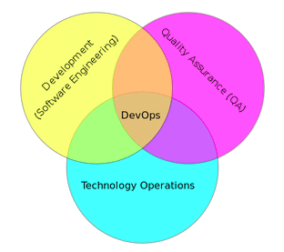
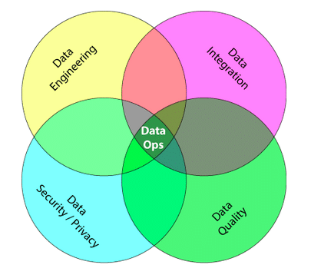
DataOps
From DevOps to DataOps
“A collaborative data management practice focused on improving the communication, integration and automation of data flows between data managers and data consumers across an organization”
Data analytics improved in terms of velocity, quality, predictability and scale of software engineering and deployment
Some key rules
Establish progress and performance measurements at every stage
Automate as many stages of the data flow as possible
Establish governance discipline (governance-as-code)
Design process for growth and extensibility
Gartner, 2020 https://www.gartner.com/smarterwithgartner/how-dataops-amplifies-data-and-analytics-business-value Andy Palmer, 2015 https://www.tamr.com/blog/from-devops-to-dataops-by-andy-palmer/ William Vorhies, 2017 https://www.datasciencecentral.com/profiles/blogs/dataops-it-s-a-secret

Slide 64
Data platform
MOSES is used within a DP that builds atop the Hadoop ecosystem
The cluster runs the Cloudera Distribution for Apache Hadoop 6.2.0 and Docker
The metadata collected and manipulated are stored in a graph database
The graph data model favors the modeling of highly interconnected data in the absence of fixed schemas
Service decoupling: functional components are accessible using RESTful APIs
Leoni Anna Giulia. "Gestione di un data lake strutturato attraverso il riconoscimento semantico dei dati acquisiti."
Orchestrator
Data Processes
MOSES
Proc. 1
Proc. 2
…
Proc. m
Metadata Extractor
Metadata Search
Engine
Provenance Manager
Storage
Trigger Engine
Other Storages
DFS
Custom components
Metadata
Process Interfaces
MOSES Interfaces
Web Interface
Other Interfaces
Workflow Administration
Metadata GUI

Slide 65
Summing up
Storage should be flexible enough to support heterogenous data models and raw data
From operational databases to DWHs (why?)
From relational data models to NoSQL (why?)
Data lake to (directly) ingest raw data
Storage, per se, is insufficient to get value from the data (examples?)
We also need data processing and fruition
Data lakes are blurring into data platforms
Data platforms support end-to-end data needs (which ones?)
Building data platforms is hard (why?)
Managing data platforms is hard, exploit meta-data to ease this task
Data lineage, compression, profiling, resolution, etc.
Open question: how do we deploy working data platforms?

Slide 66
STORAGE: NoSQL DBMSs
Not only SQL

Slide 67
Introduction
What is NoSQL
Where does it come from, and why

Slide 68
Strengths of RDBMSs
ACID properties
Provides guarantees in terms of consistency and concurrent accesses
Data integration and normalization of schemas
Several application can share and reuse the same information
Standard model and query language
The relational model and SQL are very well-known standards
The same theoretical background is shared by the different implementations
Robustness
Have been used for over 40 years

Slide 69
Weaknesses of RDBMS
Impedance mismatch
Data are stored according to the relational model, but applications to modify them typically rely on the object-oriented model
Many solutions, no standard
E.g.: Object Oriented DBMS (OODBMS), Object-Relational DBMS (ORDBMS), Object-Relational Mapping (ORM) frameworks
Painful scaling-out
Not suited for a cluster architecture
Distributing an RDBMS is neither easy nor cheap (e.g., Oracle RAC)
Consistency vs latency
Consistency is a must – even at the expense of latency
Today's applications require high reading/writing throughput with low latency
Schema rigidity
Schema evolution is often expensive

Slide 70
What NoSQL means
The term has been first used in '98 by Carlo Strozzi
It referred to an open-source RDBMS that used a query language different from SQL
In 2009 it was adopted by a meetup in San Francisco
Goal: discuss open-source projects related to the newest databases from Google and Amazon
Participants: Voldemort, Cassandra, Dynomite, HBase, Hypertable, CouchDB, MongoDB
Today, NoSQL indicates DBMSs adopting a different data model from the relational one
NoSQL = Not Only SQL
According to Strozzi himself, NoREL would have been a more proper noun

Slide 71
The first NoSQL systems
LiveJournal, 2003
Goal: reduce the number of queries on a DB from a pool of web servers
Solution: Memcached, designed to keep queries and results in RAM
Google, 2005
Goal: handle Big Data (web indexing, Maps, Gmail, etc.)
Solution: BigTable, designed for scalability and high performance on Petabytes of data
Amazon, 2007
Goal: ensure availability and reliability of its e-commerce service 24/7
Solution: DynamoDB, characterized by strong simplicity for data storage and manipulation
Notes:
https://en.wikipedia.org/wiki/LiveJournal LiveJournal è una sorta di MSN russo

Slide 72
NoSQL common features
Not just rows and tables
Several data model adopted to store and manipulate data
Freedom from joins
Joins are either not supported or discouraged
Freedom from rigid schemas
Data can be stored or queried without pre-defining a schema (schemaless or soft-schema)
Distributed, shared-nothing architecture
Trivial scalability in a distributed environment with no performance decay
Each workstation uses its own disks and RAM
SQL is dead, long live SQL!
Some systems do adopt SQL (or a SQL-like language)

Slide 73
NoSQL in the Big Data world
NoSQL systems are mainly used for operational workloads (OLTP)
Optimized for high read and write throughput on small amounts of data
Big Data technologies are mainly used for analytical workloads (OLAP)
Optimized for high read throughput on large amounts of data
Can NoSQL systems be used for OLAP?
Possibly, but through Big Data analytical tools (e.g., Spark)
Notes:
https://aws.amazon.com/it/nosql/

Slide 74
Data models

Slide 75
NoSQL: several data models
One of the key challenges is to understand which one fits best with the required application
Model | Description | Use cases
Key-value | Associates any kind of value to a string | Dictionary, lookup table, cache, file and images storage
Document | Stores hierarchical data in a tree-like structure | Documents, anything that fits into a hierarchical structure
Wide-column | Stores sparse matrixes where a cell is identified by the row and column keys | Crawling, high-variability systems, sparse matrixes
Graph | Stores vertices and arches | Social network queries, inference, pattern matching

Slide 76
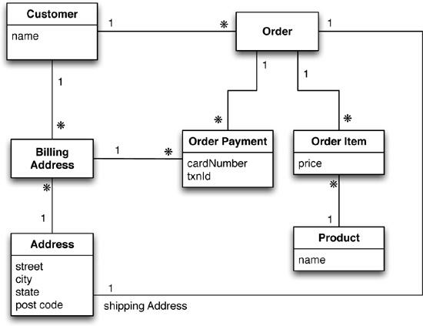
Running example
Typical use case: customers, orders and products

Slide 77
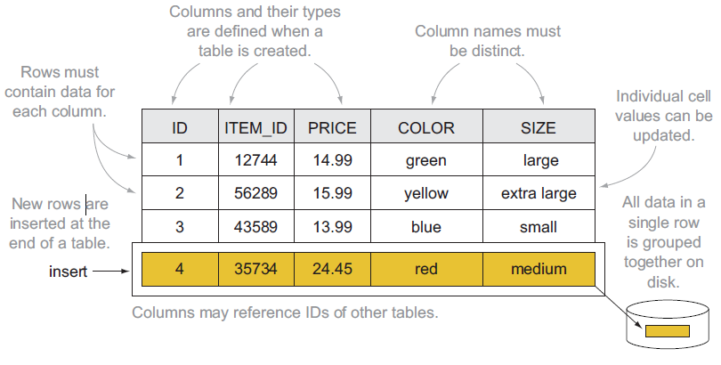
Relational: data model
Based on tables and rows

Slide 78
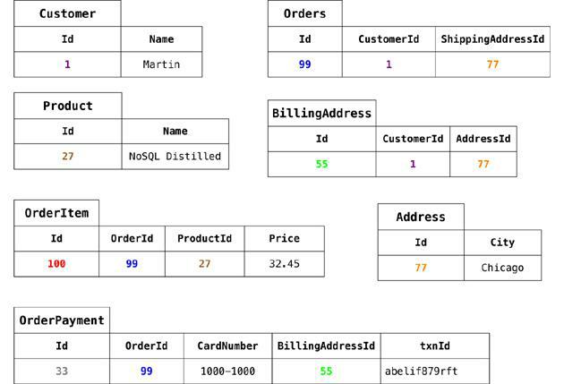
Data modeling example: relational model

Slide 79
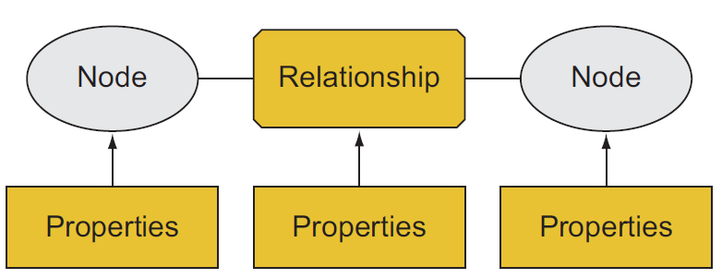
Graph: data model
Each DB contains one or more graphs
Each graph contains vertices and arcs
Vertices: usually represent real-world entities
E.g.: people, organizations, web pages, workstations, cells, books, etc.
Arcs: represent directed relationships between the vertices
E.g.: friendship, work relationship, hyperlink, ethernet links, copyright, etc.
Vertices and arcs are described by properties
Arcs are stored as physical pointers
Most known specializations:
Reticular data model
Parent-child or owner-member relationships
Triplestore
Subject-predicate-object relationships (e.g., RDF)
Notes:
https://stackoverflow.com/questions/5040617/what-is-the-difference-between-a-graph-database-and-a-network-database

Slide 80
Graph: querying
Graph databases usually model relationships-rich scenarios
The query language simplifies the navigation of these relationships
Support for transactions
Support for indexes, selections and projections
Query language based on detecting patterns
Query | Pattern
Find friends of friends | (user)-[:KNOWS]-(friend)-[:KNOWS]-(foaf)
Find shortest path from A to B | shortestPath( (userA)-[:KNOWS*..5]-(userB) )
What has been bought by those who bought my same products? | (user)-[:PURCHASED]->(product)<-[:PURCHASED]-()-[:PURCHASED]->(otherProduct)

Slide 81
Data modeling example: graph model
IDs are implicitly handled; different edge colors imply different edge types
name:Martin
CardN: 457
txnId:….
CardN: 477
txnId:….
price:14,4
price:12,4
street:Adam city:Chicago
state:illinois
code:60007
street:9th city:NewYork
state:NewYork
code:10001
name:Cola
name:Fanta

Slide 82
Graph vs Aggregate modeling
The graph data model is intrinsically different from the others
Focused on the relationships rather than on the entities per-se
Limited scalability: it is often impossible to shard a graph on several machines without "cutting" several arcs (i.e. having several cross-machine links)
Batch cross-machine queries: don’t follow relationships one by one, but "group them" to make less requests
Limit the depth of cross-machine node searches
Data-driven modeling
Key-value, document and wide-column are called aggregate-oriented
Aggregate = key-value pair, document, row (respectively)
The aggregate is the atomic block (no guarantees for multi-aggregate operations)
Based on the concept of encapsulation
Avoid joins as much as possible → achieve high scalability
Con: data denormalization → potential inconsistencies in the data
Query-driven modeling
Notes:
https://stackoverflow.com/questions/21558589/neo4j-sharding-aspect
https://ayende.com/blog/4490/that-no-sql-thing-scaling-graph-databases

Slide 83
Document: data model
Each DB contains one or more collections (corresponding to tables)
Each collection contains a list of documents (usually JSON)
Documents are hierarchically structured
Each document contains a set of fields
The ID is mandatory
Each field corresponds to a key-value pair
Key: unique string in the document
Value: either simple (string, number, boolean) or complex (object, array, BLOB)
A complex field can contain other field
{
"_id": 1234,
"name": "Enrico",
"address": {
"city": "Cesena", "postalCode": 47522
},
"contacts": [ {
"type": "office", "contact": "0547-338835"
}, {
"type": "skype", "contact": "egallinucci"
} ]
}

Slide 84
Document: querying
The query language is quite expressive
Can create indexes on fields
Can filter on the fields
Can return more documents with one query
Can select which fields to project
Can update specific fields
Different implementations, different functionalities
Some enable (possibly materialized) views
Some enable MapReduce queries
Some provide connectors to Big Data tools (e.g., Spark, Hive)
Some provide full-text search capabilities

Slide 85
Data modeling example: aggregate model (2)

Slide 86
Data modeling example: aggregate model (1)

Slide 87
Data modeling example: document model (1)
Customer collection
Product collection
{
"_id": 1,
"name": "Martin",
"adrs": [
{"street":"Adam", "city":"Chicago", "state":"illinois", "code":60007}, {"street":"9th", "city":"NewYork", "state":"NewYork", "code":10001}
],
"orders": [ {
"orderpayments":[
{"card":477, "billadrs": {"street":"Adam", "city":"Chicago", "state":"illinois", "code":60007}},
{"card":457, "billadrs": {"street":"9th", "city":"NewYork", "state":"NewYork", "code":10001}}
],
"products":[
{"id":1, "name":"Cola", "price":12.4},
{"id":2, "name":"Fanta", "price":14.4}
],
"shipAdrs": {"street":"9th", "city":"NewYork", "state":"NewYork", "code":10001}
}]
}
{
"_id":1,
"name":"Cola",
"price":12.4
},
{
"_id":2,
"name":"Fanta",
"price":14.4
}

Slide 88
Data modeling example: document model (2)
{
"_id": 1,
"name": "Martin",
"adrs": [
{"street":"Adam", "city":"Chicago", "state":"illinois", "code":60007}, {"street":"9th", "city":"NewYork", "state":"NewYork", "code":10001}
]
}
Customer
collection
{
"_id":1,
"name":"Cola",
"price":12.4
},
{
"_id":2,
"name":"Fanta",
"price":14.4
}
{
"_id": 1,
"customer":1,
"orderpayments":[
{"card":477, "billadrs":{"street":"Adam", "city":"Chicago", "state":"illinois", "code":60007}},
{"card":457, "billadrs":{"street":"9th", "city":"NewYork", "state":"NewYork", "code":10001}}
],
"products": [
{"id":1, "name":"Cola", "price":12.4},
{"id":2, "name":"Fanta", "price":14.4}
],
"shipAdrs": {"street":"9th", "city":"NewYork", "state":"NewYork", "code":10001}
}
Product
collection
Order
collection

Slide 89
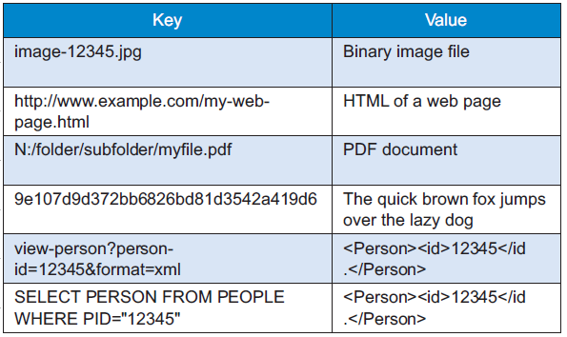
Key-value: data model
Each DB contains one or more collections (corresponding to tables)
Each collection contains a list of key-value pairs
Key: a unique string
E.g.: ids, hashes, paths, queries, REST calls
Value: a BLOB (binary large object)
E.g.: text, documents, web pages, multimedia files
Looks like a simple dictionary
The collection is indexed by key
The value may contain several information
Definitions, synonyms and antonyms, images, etc.

Slide 90
Key-value: querying
Three simple kinds of query:
put($key as xs:string, $value as item())
Adds a key-value pair to the collection
If the key already exists, the value is replaced
get($key as xs:string) as item()
Returns the value corresponding to the key (if it exists)
delete($key as xs:string)
Deletes the key-value pair
The value is a black box: it cannot be queried!
No "where" clauses
No indexes on the values
Schema information is often indicated in the key
Key | Value
user:1234:name | Enrico
user:1234:city | Cesena
post:9876:written-by | user:1234
post:9876:title | NoSQL Databases
comment:5050:reply-to | post:9876

Slide 91
Data modeling example: key-value model
Customer collection
Product collection
key | value
cust-1:name | Martin
cust-1:adrs | [ {"street":"Adam", "city":"Chicago", "state":"Illinois", "code":60007}, {"street":"9th", "city":"NewYork", "state":"NewYork", "code":10001} ]
cust-1:ord-99 | { "orderpayments": [ {"card":477, "billadrs": {"street":"Adam", "city":"Chicago", "state":"illinois", "code":60007} }, {"card":457, "billadrs": {"street":"9th", "city":"NewYork", "state":"NewYork", "code":10001} ], "products": [ {"id":1, "name":"Cola", "price":12.4}, {"id":2, "name":"Fanta", "price":14.4} ], "shipAdrs": {"street":"9th", "city":"NewYork", "state":"NewYork", code":10001} }
key | value
p-1:name | Cola
p-2:name | Fanta

Slide 92
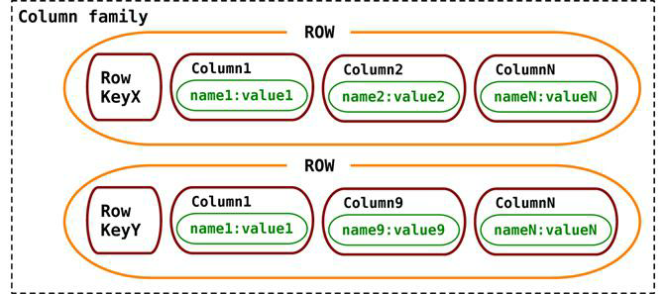
Wide column: data model
Each DB contains one or more column families (corresponding to tables)
Each column family contains a list of row in the form of a key-value pair
Key: unique string in the column family
Value: a set of columns
Each column is a key-value pair itself
Key: unique string in the row
Value: simple or complex (supercolumn)
Essentially a 2-dimensional key-value store
Rows specify only the columns for which a value exists
Particularly suited for sparse matrixes and many-to-many relationships

Slide 93
Wide column: querying
The query language expressiveness is in between key-value and document data models
Column indexes are discouraged
Can filter on column values (not always)
Can return more rows with one query
Can select which columns to project
Can update specific columns (not always)
Given the similarity with the relational model, a SQL-like language is often used

Slide 94
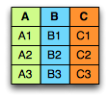
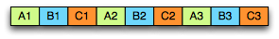
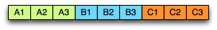
Wide column: ≠ columnar
Do not mistake the wide column data model with the columnar storage used for OLAP applications
Row-oriented
Pro: inserting a record is easy
Con: several unnecessary data may be accessed when reading a record
Column-oriented
Pro: only the required values are accessed
Con: writing a record requires multiple accesses
Row-oriented
Column-oriented

Slide 95
Data modeling example: wide-column model
Ord | CustName | Pepsi | Cola | Fanta | …
1 | Martin |  | 12.4 | 14.4
2 | … | … |  |  | …
Order details column family
Ord | OrderPayments
1
2 | …
Order payments column family
Card | Steet | City | State | Code
477 | 9th | NewYork | NewYork | 10001
457 | Adam | Chicago | Illinois | 60007

Slide 96
Aggregate modeling strategy
The aggregate term comes from Domain-Driven Design
An aggregate is a group of tightly coupled objects to be handled as a block
Aggregates are the basic unit for data manipulation and consistency management
Advantages
Can be distributed trivially
Data the should be used together (e.g., orders and details) are stored together
Facilitate the developer's job
By surpassing the impedance mismatch problem
Disadvantages
No design strategy exists for aggregates
It only depends on how they are meant to be used
Can optimize only a limited set of queries
Data denormalization → possible inconsistencies
RDBMSs are agnostic from this point of view

Slide 97
Sharding data
A look behind the curtain

Slide 98
Sharding data
One of the strengths of NoSQL systems is their scale-out capability
Aggregate data modeling: well suited for being distributed within a cluster
NoSQL systems can be used in a single server environment too
Graph databases do not scale as well as the others
Two aspects must be considered when deploying on a cluster
Sharding: distributing the data across different nodes
Replication: creating copies of the data on several nodes
Notes:
As data volumes increase, it becomes more difficult and expensive to
scale up—buy a bigger server to run the database on. A more appealing option is to
scale out—run the database on a cluster of servers. Aggregate orientation fits well
with scaling out because the aggregate is a natural unit to use for distribution.
Quando ha senso l’approccio single-server?
Mole di dati non è enorme
Si vogliono sfruttare le caratteristiche dei database NoSQL (e.g., schemaless, modello dati)
Un sistema distribuito è inevitabilmente più complesso; non è detto che ne valga sempre la pena

Slide 99
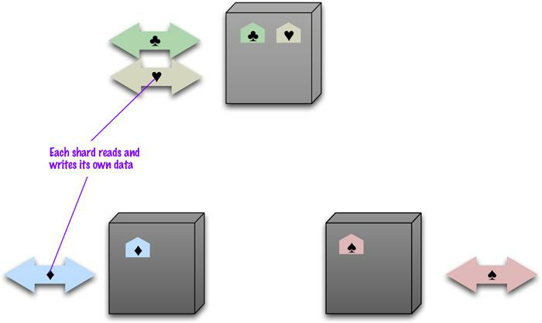
Sharding
Sharding: subdividing the data in shards that are stored in different machines
Intrinsic in a distributed DB
Improves the efficiency of the system
Read/write operations are distributed
A good sharding strategy is fundamental to optimize performances
Usually based on one or more fields composing the sharding key
Notes:
Rimosso: Non dimenticarsi che, nei cluster, si usano macchine meno affidabili – diminuisce la resistenza ai guasti

Slide 100
Sharding strategy
Thumbs-up rules for a sharding strategy:
Data-locality: stores the data close to those that need to access them
E.g., store orders of Italian customers in the European data center
Keep a balanced distribution
Each node should have the same percentage of data (more or less)
Keep together the data that must be accessed together
E.g., store each client’s orders in the same node

Slide 101
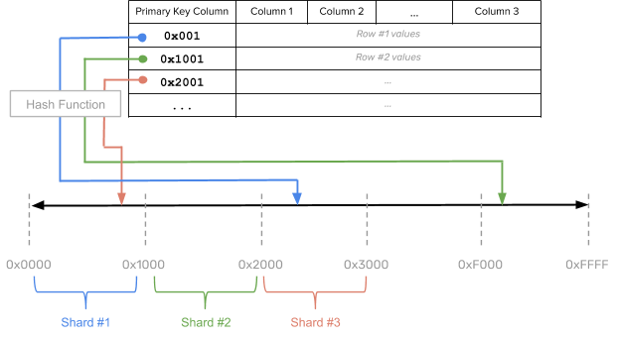
Sharding strategy
Hash strategy: a hash function is used to allocate data to partitions
Adopted by DynamoDB and Cassandra
Pro: ensures even data distribution across nodes → massive scalability
Pro: new nodes can be added without heavy data redistribution
Con: range queries become inefficient
Notes:
https://blog.yugabyte.com/four-data-sharding-strategies-we-analyzed-in-building-a-distributed-sql-database/

Slide 102
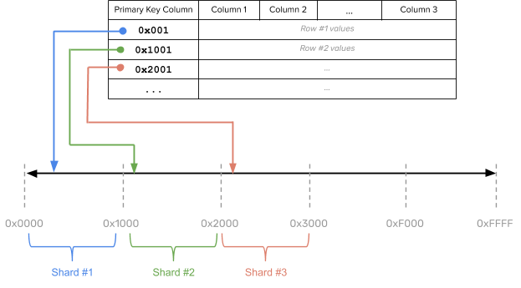
Sharding strategy
Range strategy: each partition contains a range of sorted data
Adopted by HBase
Pro: efficiently run range queries that work on the sharding key values
Con: global ordering often generates hot spots → risk of bottlenecks
Con: ranges are defined a priori and this can determine heavy data redistribution
Notes:
https://blog.yugabyte.com/four-data-sharding-strategies-we-analyzed-in-building-a-distributed-sql-database/

Slide 103
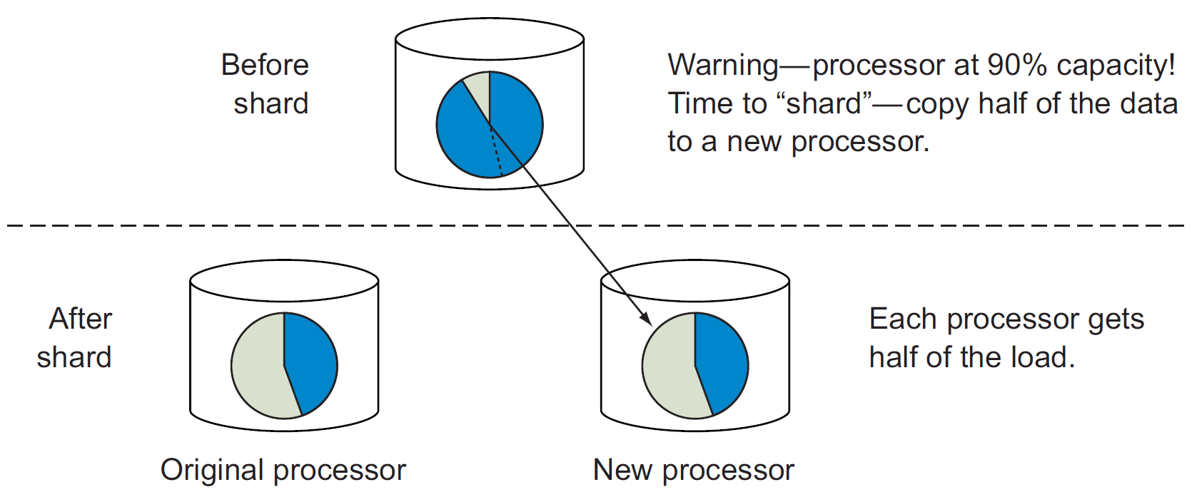
Sharding strategy
Auto-sharding: the database distributes the data according to the workload
Beware: redefining (or choosing later) the sharding strategy can be quite expensive

Slide 104
Replication
Replication: the data is copied on several nodes
Improves the robustness of the system
In case of node failure, replicas prevent data loss
Improves the efficiency of the system
More users read the same data from different copies, in parallel
Higher chance of enforcing data-locality
How to distribute the replicas?
Random (possibly topology-aware) distribution of each record
Similarly to HDFS blocks
Replication of entire instances
Main issue: each update must be pushed to every replica
Two techniques to handle updates: master-slave, peer to peer
Notes:
Parliamo di replica completa, per ora

Slide 105
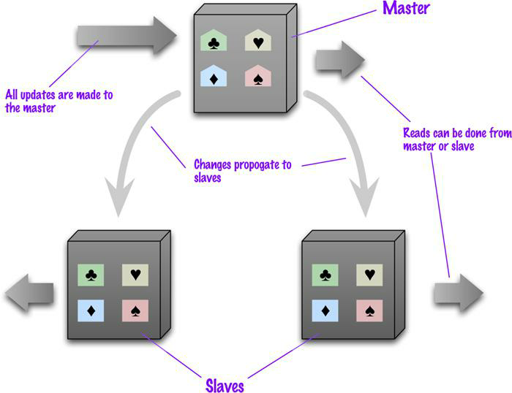
Master-Slave Replication
Master
It’s the manager of the data
Handles each and every write operation
Can be chosen or drawn
Slaves
Enable read operations
In sync with the master
Can become master if the latter fails
Notes:
Parliamo di replica completa, per ora

Slide 106
Master-Slave Replication
Pros
Easily handles many read requests
Slaves do not need the master to perform reads
Useful when the workload mainly consists of reads
Useful to avoid write conflicts
Cons
The master is a bottleneck
Only the master can handle writes
In case of failure, a new master must be drawn
Delay in write propagation can be a source of inconsistency
Two users may read different values at the same time
Read inconsistency can be problematic, but are relatively limited in time
Not ideal when the workload mainly consists of writes

Slide 107
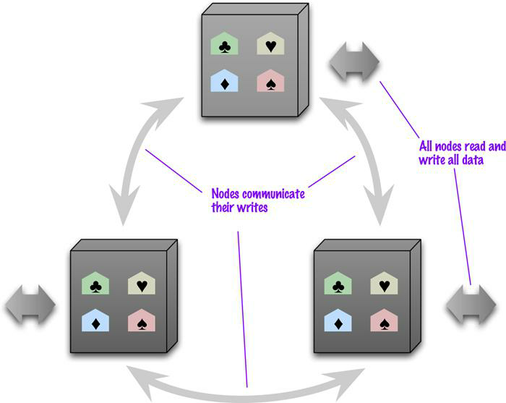
Peer-to-Peer Replication
Each node has the same importance
Each node can handle write operations
The loss of a node does not compromise reads nor writes

Slide 108
Peer-to-Peer Replication
Pro
The failure of a node does not interrupt read nor write requests
Write performances easily scale by adding new nodes
Cons
Conflicts!
Delay in write propagation can be a source of inconsistency
Same as with master-slave replication
Two users may update the same value from different replicas
Write inconsistencies are way worse
Notes:
TODO: come gestire conflitti in scrittura? Quorum, l‘ultimo vince o segnalazione.

Slide 109
Handling conflicts
Read conflicts
Tolerate conflicts: the inconsistency window is usually limited
Read-your-writes: read consistency is guaranteed for the data written by the same user
Applies only to reads that immediately follow a write operation
One way is to associate a user to a node (risk: unbalanced workloads)
Typically, versioning fields are used to ensure that the up-to-date version is read
Write conflicts (P2P model)
Last write wins: in case of conflict, the latest update overrides the others
Conflict prevention: enforce writes on the most recent version by verifying that the value hasn’t changed since the last read
Conflict detection: preserve history, merge results, and let the user decide
Notes:
Read-your-writes: https://jepsen.io/consistency/models/read-your-writes
https://highlyscalable.wordpress.com/2012/09/18/distributed-algorithms-in-nosql-databases/
Prevention: verify that the value hasn’tchanges since the last read

Slide 110
The quorum mechanism
The quorum mechanism ensures consistent IO under replication
Based on contacting a majority of the nodes responsible for certain data
The quorum is the minimum number of nodes that a distributed operation has to obtain in order to be allowed to perform an operation on a replicated data item
Each data item has N replicas
Writing quorum: W > N/2
The write operation is allowed only if W replicas can be updated
Ensures that two write operations cannot occur concurrently
Reading quorum: R > N-W
The read operation is allowed only if R replicas can be read
Ensures that (at least) one copy with the up-to-date value is read
writes w₁, w₂, w₃
N=5, W=3, R=3

Slide 111
Managing consistency
A look behind the curtain

Slide 112
RDBMS vs NoSQL: different philosophies
RDBMS come from decades of widespread usage
Strong focus on data consistency
Years of research activities to optimize performances
Highly complex systems (triggers, caching, security, etc.)
NoSQL systems are designed to succeed where RDBMSs fail
Strong focus on data sharding and high availability
Quite simple systems (for now)
Speed and manageability rather than consistency at all costs

Slide 113
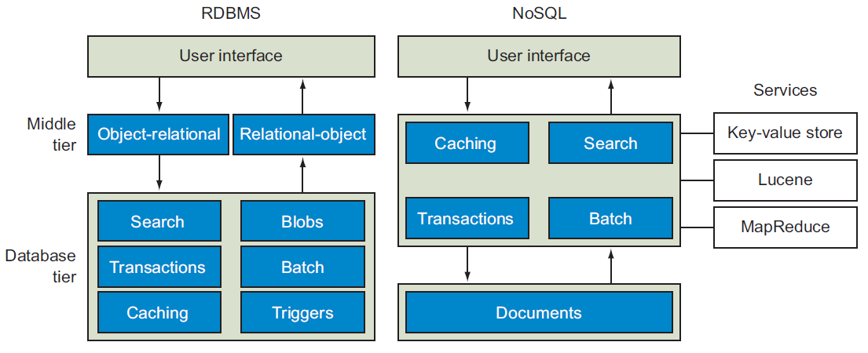
RDBMS vs NoSQL: different philosophies

Slide 114
Consistency: an example
Consider 1000€ to be transferred from bank account A to B; the transfer is made by:
Removing 1000€ from A
Adding 1000€ to B
What should never happen
The money is removed from A but not added to B
The money is added twice to B
A query on the database shows an intermediate state
E.g., A+B = 0€
RDBMS adopt transactions to avoid this kind of issue

Slide 115
Consistency in RDBMSs: ACID
Transactions guarantee four fundamental properties: ACID
Atomicity
The transaction is indivisible: either it fully completes, or it fails
It cannot be completed partially
Consistency
The transaction leaves the DB in a consistent state
Integrity constraints can never be violated
Isolation
The transaction is independent from the others
In case of concurrent transactions, the effect is the same of their sequential execution
Durability
The DBMS protects the DB from failures

Slide 116
Consistency in RDBMSs: ACID
Implementation of ACID properties relies on locking mechanisms and logs
Resources are locked, updates are logged
In case of problems, rollback to the original state
If no error occurs, unlock the resources
Consistency is guaranteed to the detriment of speed and availability
User may have to wait
Hard to replicate this mechanism in a distributed environment
But, sometimes, consistency is not that important
E.g.: e-commerce application
Shopping cart management requires speed and availability
Order emission requires consistency

Slide 117
Consistency in NoSQL
Several attempts have been made to describe NoSQL properties with respect to ACID properties
CAP theorem
PACELC theorem
BASE philosophy
They are not properties on which NoSQL systems rely
Rather, they simply try to describe their behavior

Slide 118
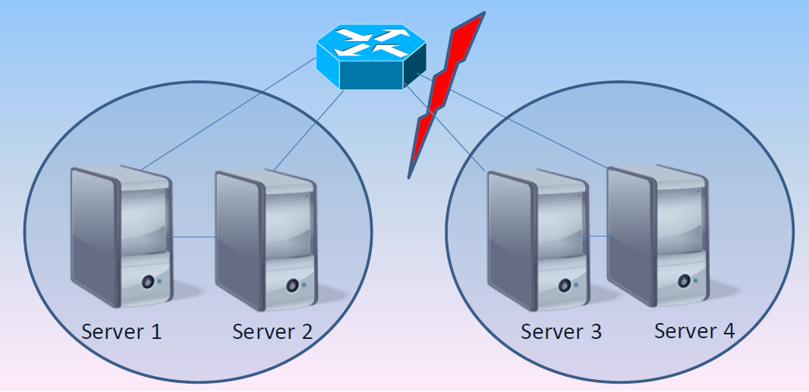
Consistency in NoSQL: CAP
"Theorem": only two of the following three properties can be guaranteed
Consistency: the system is always consistent
Every node returns the same, most recent, successful write
Every client has the same view of the data
Availability: the system is always available
Every non-failing node returns a response for all read and write requests in a reasonable amount of time
Partition tolerance: the system continues to function and upholds its consistency guarantees in spite of network partitions
In distributed systems, network partitioning is inevitably a possibility
Notes:
CAP demonstration: https://dl.acm.org/doi/pdf/10.1145/564585.564601?casa_token=m69maazxkqIAAAAA:cBn5y1eKnJUh7Tl4GVsw9Hqv984qwQ3_b8XvSM_wM3U2zp_-363uPINWJADEmMt-8ZjPzA1yaoE

Slide 119
Consistency in NoSQL: CAP
Three situations
CA: the system cannot suffer from network partitioning (single server)
AP: in case of partitioning, the system sacrifices consistency (overbooking)
CP: in case of partitioning, the system sacrifices availability (bookings prevented)
Theorem interpretation is not trivial
Asymmetric properties: consistency is sacrificed to favor speed at all times, not just when partitioning happens
Different application requirements → different algorithms handle these properties more strictly/loosely

Slide 120
Consistency in NoSQL: relaxing CAP
Consider two users that want to book the same room when a network partition happens
CP: no one can book (A is sacrificed)
Not the best solution
AP: both can book (C is sacrificed)
Possible overbooking: writing conflict to handle
caP: only one can book
The other will se the room available but cannot book it
This is admissible only in certain scenarios
Finance? Blogs? E-commerce?
It’s important to understand:
What is the tolerance to obsolete reads
How large can the inconsistency window be
Notes:
Gestione del conflitto in scrittura:
Last one wins (vince l’ultimo che arriva)
Segnalazione all’utente del conflitto
Quorum

Slide 121
Consistency in NoSQL: PACELC
Evolution of the CAP theorem (less known, but more precise)
if (Partition) then { Avaialbility or Consistency? }
Else { Latency or Consistency? }
Different behavior in case or in absence of partitioning
PA: in case of partitioning, the system sacrifices consistency (overbooking)
PC: in case of partitioning, the system sacrifices availability (bookings prevented)
EL: otherwise, the system sacrifices consistency in favor of speed
EC: otherwise, the system sacrifices speed in favor of consistency
Four situations:
PA EL: system focused on speed and availability (main NoSQL philosophy)
PA EC: consistency sacrificed only when partitioning happens
PC EL: consistency enforced only when partitioning happens (e.g., Yahoo Sherpa)
PC EC: system focused on consistency (RDBMS)
Notes:
http://dbmsmusings.blogspot.com/2010/04/problems-with-cap-and-yahoos-little.html

Slide 122
Consistency in NoSQL: BASE
The CAP theorem is often cited as a justification for the use of weaker consistency models, for example BASE
Basically Available Soft-state services with Eventual consistency
Basic Availability: the system should always be available
Soft-state: it is acceptable for the system to be temporarily inconsistent
Eventual consistency: eventually, the system becomes consistent
ACID
Pessimistic approach (better safe than sorry)
BASE
Optimistic approach (everything is going to be ok)
Higher throughput is better than enforcing consistency

Slide 123
Consistency in NoSQL: summary
Source | Cause | Effect | Solution
Replication (MS and P2P) | Write propagation delay between replicas is slow | Read conflicts | - Tolerate - Read-your-writes - Quorum
Replication (P2P) | Two write operations can be issued on different replicas | Write conflicts | - Last write wins - Conflict prevention - Conflict detection - Quorum
Network partitioning | Inability to communicate with all replicas of a certain data | - Read conflicts - Possibly write conflicts | - Relax CAP - Prevent write conflicts - Handle read conflict as above
No ACID transactions | - An update over multiple records fails mid-query - Two updates over multiple records are interleaved | Unrecoverable inconsistency | - Each system provides its own mechanism to offer limited ACID-like transactions
Data de-normalization | The same data is repeated in different instances with different values | Inability to find the correct values | - Avoid denormalization if strong consistency is needed - Data cleaning before analysis

Slide 124
One size does not fit all
To each application its own data model

Slide 125
Key-Value: popular DBs
Redis (Data Structure server): http://redis.io/
Supports complex fields (list, set, …) and operations on values (range, diff, …)
Memcached DB: http://memcached.org/
Riak: http://basho.com/riak/

Slide 126
Key-Value: when to use
Very simple use cases
Independent data (no need to model relationships)
The typical query is a simple lookup
Need super-fast performance
Examples
Session information
Each web session is identified by its own sessionId: All related data can be stored with a PUT request and returned with a GET request
User profiles, preferences
Each user is uniquely identified (userId, username) and has her own preferences in terms of language, colors, timezone, products, etc. – data that fits well within an aggregate
Shopping cart, chat services
Each e-commerce websites associates a shopping cart to a user; it can be stored as an aggregate identified by the user ID
Notes:
1 RDBMS would be overkill

Slide 127
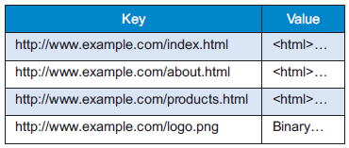
Key-Value: real use cases
Crawling of web pages
The URL is the key, the whole page content (HTML, CSS, JS, images, ..) is the value
Twitter timeline
The user ID is the key, the list of most recent tweets to be shown is the value
Amazon S3 (Simple Storage Service)
A cloud-based file system service
Useful for personal backups, file sharing, website or apps publication
The more you store, the more you pay
Storage: approx. $0.03 per GB per month
Uploading files: approx. $0.005 per 1000 items
Downloading files: approx. $0.004 per 10,000 files* PLUS $0.09 per GB (first GB free)
Notes:
1 RDBMS would be overkill
https://www.infoq.com/presentations/Real-Time-Delivery-Twitter
http://highscalability.com/blog/2014/9/8/how-twitter-uses-redis-to-scale-105tb-ram-39mm-qps-10000-ins.html
https://www.quora.com/Why-is-Twitter-not-using-NoSQL

Slide 128
Key-Value: when to avoid
Data with many relationships
When relationships between data (in the same or in different collections) must be followed
Some systems offer limited link-walking mechanisms
Multi-record operations
Because operations (mostly) involve one record at a time
Querying the data
If it is necessary to query the values, not just the key
Few systems offer limited functionalities (e.g., Riak Search)

Slide 129
Document: popular DBs
MongoDB: http://www.mongodb.org
Couchbase: http://www.couchbase.com
CouchDB: http://couchdb.apache.org

Slide 130
Document: when to use
Higher expressiveness
Store data according to a highly nested data model
Need to formulate complex queries on many fields
Examples
Event logs
Central repo to store event logs from many applications; shard on app name or event type
CMS, blogging platforms
The absence of a predefined schema fits well within content management systems (CMS) or website management applications, to handle comments, registrations and user profiles
Web Analytics or Real-Time Analytics
The ability to update only specific fields enables fast update of analytical metrics
Text indexing enables real-time sentiment analysis and social media monitoring
E-commerce applications
Schema flexibility is often required to store products and orders, as well as to enable schema evolution without incurring into refactoring or migration costs

Slide 131
Document: real use cases
Adversting services
MongoDB was born as a system for banner ads
24/7 availability and high performance
Complex rules to find the right banner based on user’s interests
Handle several kinds of ads and show detailed analytics
Internet of Things
Real-time management of sensor-based data
Bosch uses MongoDB to capture data from cars (breaks, ABS, windscreen wiper, etc.) and aircrafts maintenance tools
Business rules are applied to warn the pilot when the breaking system pressure falls under a critical threshold, or the maintenance operator when the tool is used improperly
Technogym uses MongoDB to capture data from gym equipment

Slide 132
Document: when to avoid
ACID transactions requirement
If not for a few exceptions (e.g., RavenDB), document databases are not suited for cross-document atomicity
Queries on high-variety data
If the aggregate structure continuously evolves, queries must be constantly updated (and normalization clashes with the concept of aggregate)

Slide 133
Wide column: popular DBs
Cassandra: http://cassandra.apache.org
HBase: https://hbase.apache.org
Google BigTable: https://cloud.google.com/bigtable

Slide 134
Wide column: when to use
Compromise between expressiveness and simplicity
Limited (but some) requirements in terms of data model
Limited (but some) requirements in terms of querying records
Examples
Event logs; CMS, blogging platforms
Similarly to document databases, different applications may use different columns
Sparse matrixes
While an RDBMS would store null values, a wide column stores only the columns for which a value is specified
GIS applications
Pieces of a map (tiles) can be stored as couples of latitude and longitude

Slide 135
Wide column: real use cases
Google applications
BigTable is the DB used by Google for most of its applications, including Search, Analytics, Maps and Gmail
User profiles and preferences
Spotify uses Cassandra to store metadata about users, artists, songs, playlists, etc.
Manhattan
After using Cassandra, Twitter ha developed its own proprietary NoSQL system to support most of its services
Notes:
Netflix: 12M trans/sec. Ebay, >100TB. IoT
https://labs.spotify.com/2015/01/09/personalization-at-spotify-using-cassandra/
https://academy.datastax.com/resources/ds220-data-modeling?unit=use-cases-use-case-introduction

Slide 136
Wide column: when to avoid
Same as for document model
ACID transactions requirement
Queries on high-variety data
Need for full query expressiveness
Joins are highly discouraged
Limited support for filters and group bys
Notes:
Prototipazioni: nelle prima fasi di progetto, i pattern delle query possono cambiare frequentemente, con la conseguenza di dover riprogettare le famiglie di colonne. In Cassandra, the cost may be higher for query change as compared to schema change.

Slide 137
Graph: popular DBs
Neo4J: http://neo4j.com
TigerGraph: https://www.tigergraph.com/

Slide 138
Graph: when to use
Interlinked data
Social networks are one of the most typical use case of graph databases (e.g., to store friendships or work relationships); every relationship-centric domain is a good one
Routing and location-based services
Applications working on the TSP (Travelling Salesman Problem) problem
Location-based application that, for instance, recommend the best restaurant nearby; in this case, relationships model the distance between node
Recommendation applications, fraud-detection
Systems recommending «the products bought by your friends», or «the products bought by those who bought your same products»
When relationships model behaviors, outlier detection may be useful to identify frauds

Slide 139
Graph: real use cases
Relationships analysis
Finding common friends (e.g., friend-of-a-friend) in a social network
Identifying clusters of phone calls that identify a criminal network
Analyzing flows of money to identifying money recycling patterns or credit card theft
Main users: law firms, police, intelligence agencies
https://neo4j.com/use-cases/fraud-detection/
Useful for text analysis as well (Natural Language Processing)
Inference
Creating rules that define new knowledge based on existing patterns (e.g., transitive relationships, trust mechanisms)
Notes:
https://developer.ibm.com/dwblog/2017/detecting-complex-fraud-real-time-graph-databases/

Slide 140
Graph: when to avoid
Data-intensive applications
Traversing the graph is trivial, but analyzing the whole graph can be expensive
There exist framework for distributed graph analysis (e.g., Apache Giraph), but they do not rely on a graph DB

Slide 141
Polyglot persistence

Slide 142
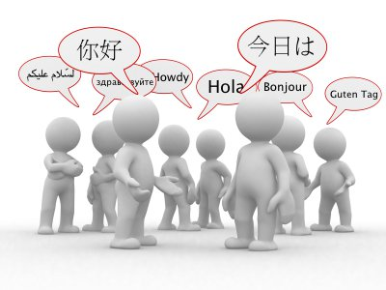
Polyglot persistence
Different databases are designed to solve different problems
Using a single DBMS to handle everything …
Operational data
Temporary session information
Graph traversing
OLAP analyses
…
… usually lead to inefficient solutions
Each activity has its own requirements (availability, consistency, fault tolerance, etc.)
Notes:
Termine derivato da "programmazione poliglotta"

Slide 143
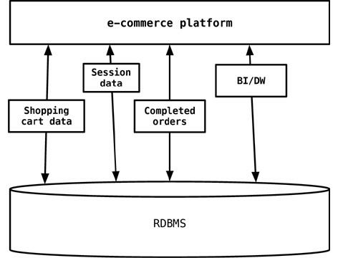
Traditional approach
The one-size-fits-all solution
Notes:
The session, shopping cart, or order data do not need the same properties of availability, consistency, or backup requirements. Does session management storage need the same rigorous backup/recovery strategy as the e-commerce orders data? Does the session management storage need more availability of an instance of database engine to write/read session data?
In 2006, Neal Ford coined the term polyglot programming, to express the idea that applications should be written in a mix of languages to take advantage of the fact that different languages are suitable for tackling different problems. Complex applications combine different types of problems, so picking the right language for each job may be more productive than trying to fit all aspects into a single language.

Slide 144
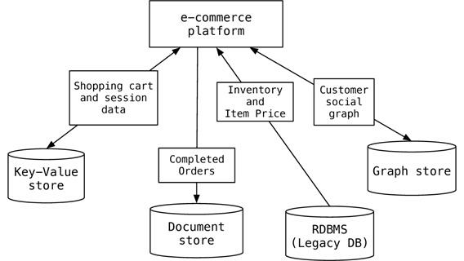
Polyglot data management
The one-size-fits-all solution
Replaced by the polyglot solution
Notes:
A key-value data store could be used to store the shopping cart data before the order is confirmed by the customer and also store the session data so that the RDBMS is not used for this transient data. Key-value stores make sense here since the shopping cart is usually accessed by user ID and, once confirmed and paid by the customer, can be saved in the RDBMS. Similarly, session data is keyed by the session ID. If we need to recommend products to customers when they place products into their shopping carts—for example, “ your friends also bought these products” or “ your friends bought these accessories for this product”—then introducing a graph data store in the mix becomes relevant.
Even using specialized relational databases for different purposes, such as data warehousing appliances or analytics appliances within the same application, can be viewed as polyglot persistence

Slide 145
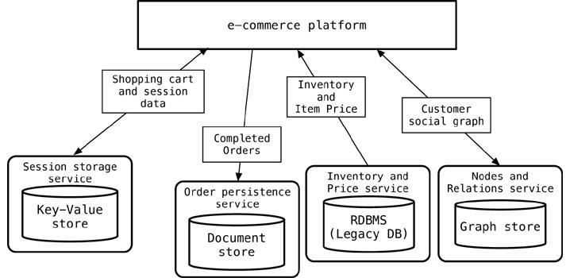
Service-oriented polyglot data management
Each DB should be "embedded" within services, which offer API services to enable data access and manipulation
Several NoSQL systems (e.g., Riak, Neo4J) already provide REST APIs

Slide 146
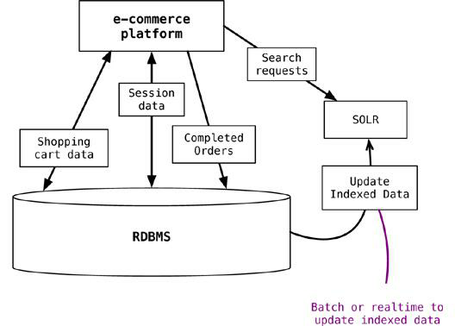
Supporting existing technologies
If the current solution cannot be changed, NoSQL systems can still support the existing ones
Notes:
While doing this, we need to update the indexed data as the data in the application database changes. The process of updating the data can be real-time or batch, as long as we ensure that the application can deal with stale data in the index/search engine. The event sourcing (“ Event Sourcing,” p. 142) pattern can be used to update the index.

Slide 147
Beyond NoSQL
NewSQL systems
Combine the benefits from both relational and NoSQL worlds
Ensure scalability without compromising consistency, but by compromising some availability
Extended RDBMSs
KV implementable as a table with two fields: a string key, and a blob value
Cypher query language on top of a relational implementation of a graph
Hstore data type in PostgreSQL for wide-column-like implementation
Scalabilty issue remains
Multi-model NoSQL DBMSs
ArangoDB, OrientDB
Support all NoSQL data models, but not the relational one
Database-as-a-service
All cloud providers offer storage services supporting all data models

Slide 148
BIG DATA AND CLOUD PLATFORMS
Building data pipelines
Notes:
https://catalog.us-east-1.prod.workshops.aws/workshops/ea7ddf16-5e0a-4ec7-b54e-5cadf3028b78/en-US

Slide 149
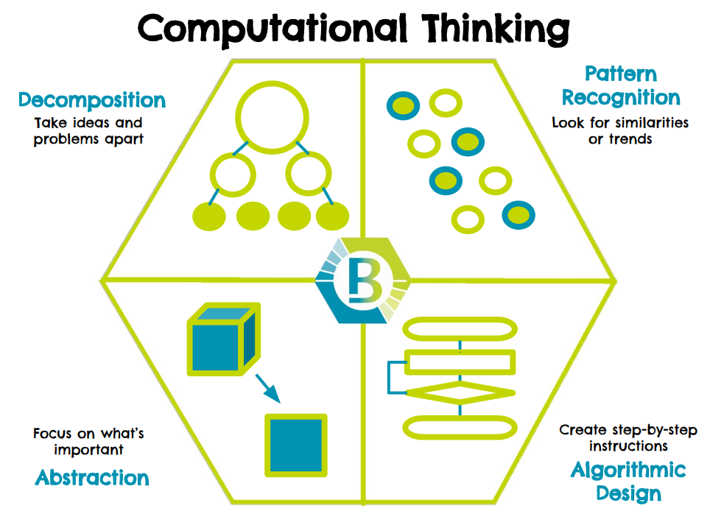
A necessary introduction
Computational thinking: solving problems using concepts and ideas from computer science.
Take a complex problem
Understand better what the problem involves
Develop possible solutions
Present these solutions in a way that a computer, human or both can understand
Pillars to computational thinking:
Decomposition
Pattern recognition
Data representation
Abstraction

Slide 150
Computational thinking
Decomposition
Taking a complex problem and breaking it into more manageable sub-problems.
The solution to each sub-problem may be much simpler by putting together the solutions to the sub-problems (any example?)
Pattern recognition
Find patterns among the sub-problems
Identify problems sharing similarities or characteristics
Discovering these patterns make the complex problem easier to solve since we can use the same solution for each occurrence of the pattern (any example?)

Slide 151
Computational thinking
Data representation and abstraction
Determining the important characteristics of the problem and filtering out those that are not
Can create a representation of what we're trying to solve
Algorithm
A set of step-by-step instructions of how to solve a problem.
It identifies what is to be done (the instructions), and the order in which they should be done
… there is no magic in programming computers

Slide 152
Integrated analytics lab
Requirements:
Knowledge of programming, data structures, and algorithms
Acquaintance with Python programming and notebooks
The labs will be mainly guided…
… but the notebooks contain all the details
… no time for a complete (coding) discussion during the lectures
Focus on the problem understanding, definition, and solution!

Slide 153
Integrated analytics lab
Building data pipelines
Frame the problem and look at the big picture
Get the data
Explore the data to gain insights
Prepare the data
Explore different models and find the best ones
Fine-tune your models
Present your solution
Launch, monitor, and maintain your system

Slide 154
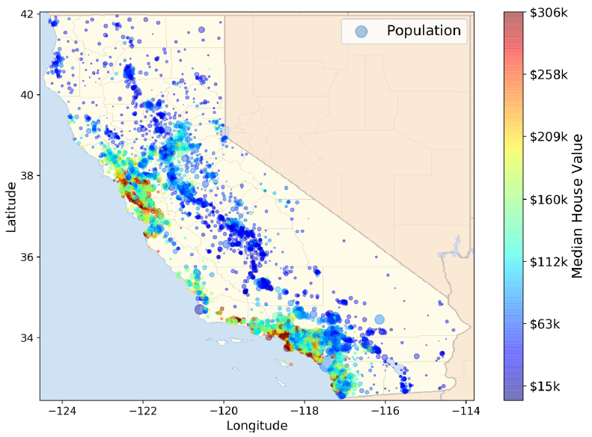
Integrated analytics lab
Building data pipelines
Frame the problem and look at the big picture
"We’ll use the California Housing Prices. Our task is to use California census data to forecast housing prices given the population, median income, and median housing price for each block group in California. Block groups are the smallest geographical unit for which the US Census Bureau publishes sample data (a block group typically has a population of 600 to 3,000 people)"

Slide 155
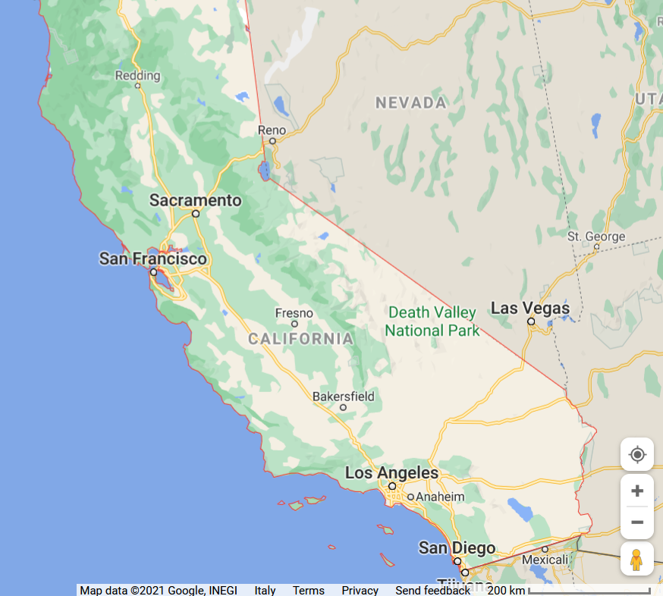
Integrated analytics lab

Slide 156

Integrated analytics lab
Building data pipelines
Frame the problem and look at the big picture
Knowing the objective is important because it will determine how you frame the problem, which algorithms you will select, which performance measure you will use to evaluate your model, and how much effort you will spend tweaking it.
"Your boss answers that your model’s output (a prediction of a district’s median housing price) will be fed to another Machine Learning system, along with many other signals. This downstream system will determine whether it is worth investing in a given area or not. Getting this right is critical, as it directly affects revenue."

Slide 157
Integrated analytics lab
Building data pipelines
Frame the problem and look at the big picture
✔Define the objective in business terms
✖How should performance be measured? (postponed for later)
Get the data
✔ List the data you need and how much you need
Data could be available in a relational database and/or spread across multiple tables/documents/files
In this project, however, things are much simpler
Explore the data to gain insights
✔ Create an environment to keep track of your data exploration
You have been provided with notebook environments
✔ Study each attribute and its characteristics
Let's do this!

Slide 158
In action

Slide 159
BIG DATA AND CLOUD PLATFORMS
Cloud computing

Slide 160

https://xkcd.com/1444/

Slide 161
Reference scenario
The big-data cube
Volume: small to big
Variety: structure to unstructured
Velocity: pull to push
Small
Volume
Structured
Big
Variety
(data model)
Unstructured
High
Velocity
Low
(pull)
(
(
push
latency
)
)
Meijer, Erik. "Your mouse is a database." Communications of the ACM 55.5 (2012): 66-73.

Slide 162


Reference scenario
Variety
Structured
Relational tuples with FK/PK relationships
Unstructured
Key-value
Columnar
Document-based
Graph
...
https://www.datamation.com/big-data/structured-vs-unstructured-data/ (accessed 2022-08-01)

Slide 163

Reference scenario
Velocity (latency)
High: clients synchronously pulling data from sources
Low: sources asynchronously pushing data to clients
Velocity (speed; dual to latency)
High: processing in real-time (milliseconds) or near-real time (minutes)
Low: processing can take hours

Slide 164
Reference scenario
Acceleration
Velocity is not constant, data comes in bursts
Take Twitter as an example
Hashtags can become hugely popular and appear hundreds of times in just seconds
… or slow down to one tag an hour
Your system must be able to efficiently handle the peak as well as the lows

Slide 165




Reference scenario
https://www.domo.com/learn/data-never-sleeps-9

Slide 166
Reference scenario
The Netflix scenario
https://www.domo.com/learn/data-never-sleeps-9

Slide 167
Reference scenario
Collecting data
Processing data
Scheduled Batch
Large volume of data processed on a regular scheduled basis
Velocity is very predictable
Periodic:
Data processed at irregular times (e.g., after collecting a certain ---large--- amount of data)
Velocity is less predictable
Near real-time
Streaming data processed in small individual batches collected and processed within minutes
Velocity is a huge concern
Real-time
Streaming data collected and processed in very small individual batches within milliseconds
Velocity is the paramount concern
Batch and periodic
Once data has been collected, processing can be done in a controlled environment
There is time to plan for the appropriate resources
Near real-time and real-time
Collection of the data leads to an immediate need for processing
Depending on the complexity of the processing (cleansing, scrubbing, curation), this can slow down the velocity of the solution significantly
Plan accordingly

Slide 168
Reference scenario
Plus other Vs
Veracity: data trustworthiness/quality
Value: ability to extract meaningful information
…
Our focus
(Un)Structured big-data batch
(Un)Structured big-data streams
Goal: keep in mind the cube to
categorize the services
Small
Volume
Structured
Big
Variety
(data model)
Batch
Stream
Unstructured
High
Velocity
Low
(pull)
(
(
push
latency
)
)

Slide 169
Reference scenario
Scenario 1
My business has a set of 15 JSON data files that are each about 2.5 GB in size.
They are placed on a file server once an hour, and they must be ingested as soon as they arrive in this location.
Data must be combined with all transactions from financial dashboard for this same period, then compared to the recommendations from marketing engine
All data is fully cleansed.
The results from this time period must be made available to decision makers by 10 minutes after the hour in the form of financial dashboards.
Which Vs are involved?

Slide 170
Reference scenario
Scenario 1
My business has a set of 15 JSON data files that are each about 2.5 GB in size.
They are placed on a file server once an hour, and they must be ingested as soon as they arrive in this location.
Data must be combined with all transactions from financial dashboard for this same period, then compared to the recommendations from marketing engine
All data is fully cleansed.
The results from this time period must be made available to decision makers by 10 minutes after the hour in the form of financial dashboards.
Which Vs are involved?
Volume This scenario describes huge JSON files to be combined with transactional data and marketing data.
Velocity "Wait - now hurry up!" Wait to collect data for a full hour and then produce meaningful results in 10 minutes (is it batch or stream processing?)
Variety three data source types: log files, transactional data, and recommendation information
Value populate dashboards that are used by decision makers as soon as they are made available. The value is reached because it requires an understanding of what the organization is trying to accomplish

Slide 171
Reference scenario
Scenario 2
My business compiles data generated by hundreds of corporations.
This data is delivered to us in very large files, transactional updates, and even data streams.
The data must be cleansed and prepared to ensure that rogue inputs do not skew the results.
Knowing the data source for each record is vital to the work we do.
A large portion of the data gathered is irrelevant to our analysis, so this data must be eliminated.
The final requirement is that all data must be combined and loaded into our data warehouse, where it will be analyzed.
Which Vs are involved?

Slide 172
Reference scenario
Scenario 2
My business compiles data generated by hundreds of corporations.
This data is delivered to us in very large files, transactional updates, and even data streams.
The data must be cleansed and prepared to ensure that rogue inputs do not skew the results.
Knowing the data source for each record is vital to the work we do.
A large portion of the data gathered is irrelevant to our analysis, so this data must be eliminated.
The final requirement is that all data must be combined and loaded into our data warehouse, where it will be analyzed.
Which Vs are involved?
Volume The data is delivered in very large files, transactional updates, and even in data streams
Variety The business will need to combine the data from all three sources into a single data warehouse.
Veracity The data is known to be suspect. The data must be cleansed and prepared to ensure that rogue inputs do not skew the results. Knowing the data source for each record is vital to the work we do.

Slide 173
Data-driven companies
Data-driven company refers to companies where decisions and processes are supported by data
Decisions are based on quantitative rather than qualitative knowledge
Processes & Knowledge are an asset of the company and are not lost if managers change
The gap between a data-driven decision and a good decision is a good manager
Adopting a data-driven mindset goes far beyond adopting a business intelligence solution and entails:
Create a data culture
Change the mindset of managers
Change processes
Improve the quality of all the data

Slide 174
Why going cloud?
Digitalization is a journey that involves three main dimensions
Moving from A to B is a multi-year process made of intermediate goals
Each of which must be feasible
Solves a company pain and brings value
Can be accomplished in a limited time range (typically less than one year)
Costs must be economically related to gains
Are processes extensively digitalized and produces reliable data?
Technological infrastructure
B
Do we have the right persons to drive the project and exploit the results?
Data quality
& quantity
Is the technogical infrastructure appropriate to support data collection and analysis?
A
Digital culture

Slide 175
Why going cloud?
Cloud computing (National Institute of Standards and Technology)
“A model for enabling ubiquitous, convenient, on-demand network access to a shared pool of configurable computing resources (e.g., networks, servers, storage, services) that can be rapidly provisioned and released with minimal management effort or service provider interaction.”
On-demand self-service (consume services when you want)
Broad network access (consume services from anywhere)
Resource pooling (infrastructure, virtual platforms, and applications)
Rapid elasticity (enable horizontal scalability)
Measured service (pay for the service you consume as you consume)
Digital transformation involves the cloud to create/change business flows
Often involves changing the company culture to adapt to this new way of doing business
One of the end goal is to meet ever-changing business and market demand

Slide 176
Why going cloud?
Goal: adjusts capacity to have predictable performance at the lowest cost
Scalability that is not possible on premises
Scale from one to thousands of servers
Elasticity
Automatically scale resources in response to run-time conditions
Adapt to changes in workload by turning on/off resources to match the necessary capacity
Core justification for the cloud adoption

Slide 177

Why going cloud?
Hardware scalability
No longer think about rack space, switches, and power supplies, etc.
Grow storage from GBs to PBs
1PB: one hundred 10TB Enterprise Capacity 3.5 HDD hard drives
https://blog.seagate.com/business/linus-tech-tips-want-petabyte-system/

Slide 178
Why going cloud?
Resource pooling
Enable cost-sharing, a resource to serve different consumers
Resources are dynamically reassigned according to demands
Based on virtualization, running multiple virtual instances on top of a physical computer system
Economy of scale for physical resources
Reliability
Built to handle failures
Fault-tolerant or highly available

Slide 179
Why going cloud?
Worldwide deployment
Deploy applications as close to customers as possible
E.g., to reduce network latency
Improve data locality
Compliant to privacy regulations (e.g., GDPR)
Measured quality of service
Services leverage a quantitative qualitative metering capability making pay-as-you-go (or pay-per-use) billing and validation of the service quality available

Slide 180
Why going cloud?
Service integration
Do not reinvent the wheel, eliminate repetitive tasks
Use services that solve common problems (e.g., load balancing, queuing)
Abstract and automatically adapt the architecture to requirements
E.g., create (test) environments on demand
Integration and abstraction are drivers of change
From databases to data platforms
From on-premises to serverless architectures
From custom to standardized data pipelines

Slide 181

Is cloud a silver bullet?
https://www.reuters.com/article/us-france-ovh-fire-idUSKBN2B20NU

Slide 182
Is cloud a silver bullet?
Cloud computing is the outsourcing of a company’s hardware and software architecture
Which are the risks and issues?
Notes:
Google has a long track record on clean energy: in 2007, Google became the first major company to become carbon neutral. And in 2017, Google became the first company of our size to match 100% of its electricity consumption with renewable energy. Today, Google Cloud is the only major cloud provider to purchase enough renewable energy to cover our entire operations, and over the years, we’ve purchased more wind and solar power than any other corporation in history.
But wind and solar power don’t work in all places at all times. Though we buy enough renewable energy on average to match our data centers’ electricity consumption, that average is an annual average. Thus, for a particular data center, at any given time we may have too much renewable power, or too little. When we have too much, we feed it into the local grid so someone else can consume it. When we have too little, we draw power from the local grid, and that power may not be renewable.

Slide 183


Is cloud a silver bullet?
Left: Mytton, David. "Data centre water consumption." npj Clean Water 4.1 (2021): 1-6. Right: https://cloud.google.com/blog/topics/inside-google-cloud/announcing-round-the-clock-clean-energy-for-cloud (accessed 2022-08-01)
Notes:
Google has a long track record on clean energy: in 2007, Google became the first major company to become carbon neutral. And in 2017, Google became the first company of our size to match 100% of its electricity consumption with renewable energy. Today, Google Cloud is the only major cloud provider to purchase enough renewable energy to cover our entire operations, and over the years, we’ve purchased more wind and solar power than any other corporation in history.
But wind and solar power don’t work in all places at all times. Though we buy enough renewable energy on average to match our data centers’ electricity consumption, that average is an annual average. Thus, for a particular data center, at any given time we may have too much renewable power, or too little. When we have too much, we feed it into the local grid so someone else can consume it. When we have too little, we draw power from the local grid, and that power may not be renewable.

Slide 184

https://xkcd.com/908/

Slide 185

Cloud computing: types of cloud
There are different types of cloud
Public: accessible to anyone willing to pay (e.g., Microsoft, AWS, Google)
Private: accessible by individuals within an institution
In public cloud, any resources that you are not using can be used by other
Users share the costs
Cost-sharing disappears in private clouds
Hybrid: a mix of the previous

Slide 186

Cloud computing: types of cloud
Cloud services are hosted in separate geographic areas
Locations are composed of regions and availability zones
Region (e.g., us-east-1)
Is an independent geographical area that groups data centers
Has availability zones
Availability zones in a region
A data center
Connected through low-latency links
Resources are usually replicated across zones but not regions
https://docs.aws.amazon.com/AWSEC2/latest/UserGuide/using-regions-availability-zones.html

Slide 187

Cloud computing: principal vendors
Gartner Magic Quadrant
Understanding the technology providers to consider for an investment
Leaders execute well and are well positioned for tomorrow
Visionaries understand where the market is going but do not yet execute well
Niche Players focus successfully on a small segment, or are unfocused and do not out-innovate or outperform others
Challengers execute well but do not demonstrate an understanding of market direction
Focusing on leaders isn’t always the best
A niche player may support needs better than a market leader. It depends on how the provider aligns with business goals
https://www.gartner.com/en/research/methodologies/magic-quadrants-research

Slide 188
Cloud computing: deployment models
On a cloud architecture, you can rely on serverless or managed services
Serverless
Standalone independent services built for a specific purpose and integrated by cloud service provider
No visibility into the machines
There are still servers in serverless, but they are abstracted away
No server management, do not have to manage any servers or scale them
E.g., when you run a query on BigQuery you do not know how many machines were used
Pay for what your application uses, usually per request or per usage
(Fully) Managed
Visibility and control of machines
You can choose the number of machines that are being used to run your application
Do not have to set up any machines, the management and backup are taken care for you
Pay for machine runtime, however long you run the machines and resources that your application uses
https://cloud.google.com/blog/topics/developers-practitioners/serverless-vs-fully-managed-whats-difference (accessed 2020-08-01)

Slide 189

Cloud computing: deployment models
Understanding architectures is paramount to successful systems
Good architectures help to scale
Poor architectures cause issues that necessitate a costly rewrite
XaaS (anything as a service)
A collective term that refers to the delivery of anything as a service
It encompasses the products, tools and technologies that vendors deliver to users

Slide 190
Cloud computing: deployment models
On-premises
Provisioning servers is time-consuming
A non-trivial environment is hard to set up
Require dedicated operations people
Often a distraction from strategic tasks
On premises
Applications
Data
Runtime
OS
manage
Virtualization
You
Servers
Storage
Networking

Slide 191
Cloud computing: deployment models
Infrastructure as a service (IaaS)
A computing infrastructure provisioned and managed over the internet (e.g., AWS EC2)
Avoid expense/complexity of buying/managing physical servers/data-centers
IaaS overcomes issues on-premises
Possibly requires to manage many environments
IaaS
Applications
Data
manage
Runtime
You
OS
Virtualization
Servers
Storage
Networking

Slide 192
Cloud computing: deployment models
Platform as a Service (PaaS)
A development and deployment environment in the cloud (e.g., AWS Elastic Beanstalk)
Support complete application life-cycle: building, testing, deploying, etc.
Avoid expense/complexity of managing licenses and application infrastructure
PaaS
Applications
manage
You
Data
Runtime
OS
Virtualization
Servers
Storage
Networking

Slide 193
Cloud computing: deployment models
PaaS and containers are potential solutions to inconsistent infrastructures
PaaS provides a platform for users to run their software
Developers write software targeting features/capabilities of the platform
Containerization isolates an application with its own environment
Lightweight alternative to full virtualization
Containers are isolated but need to be deployed to (public/private) server
Excellent solution when dependencies are in play
Housekeeping challenges and complexities

Slide 194

Cloud computing: deployment models
Containers and virtual machines are packaged computing environments
Containers
On top of physical server and its host OS
Share the host OS kernel
Shared components are read-only
“Light”, take seconds to start
Virtual machines
Emulate a hardware/software system
On top of a hypervisor (VM monitor)

Slide 195
Cloud computing: deployment models
Function as a Service (FaaS)
A coding environment, cloud provider provisions platform to run the code (e.g., AWS Lambda)
Infrastructure provisioning and management are invisible to the developer
FaaS
Applications
manage
You
Data
Runtime
OS
Virtualization
Servers
Storage
Networking

Slide 196
Cloud computing: deployment models
Principles of FaaS architectures
FaaS is based on a serverless approach, use a compute service to execute code on demand
Every function could be considered as a standalone service
Write single-purpose stateless functions
Functions react to events
Design push-based, event-driven pipelines
Create thicker, more powerful front ends
Embrace third-party services (e.g., security)
FaaS is not a silver bullet
Not appropriate for latency-sensitive applications
Strict specific service-level agreements
Migration costs
Vendor lock-in can be an issue

Slide 197
Cloud computing: deployment models
Software as a service (SaaS)
An application environment
Access cloud-based apps over the Internet (e.g., email, Microsoft Office 365, Github)
SaaS
Applications
Data
Runtime
OS
Virtualization
Servers
Storage
Networking

Slide 198

https://xkcd.com/1084/

Slide 199
BIG DATA AND CLOUD PLATFORMS
From data lake to data warehouse
Notes:
https://catalog.us-east-1.prod.workshops.aws/workshops/ea7ddf16-5e0a-4ec7-b54e-5cadf3028b78/en-US

Slide 200





Context: Soil moisture monitoring
Optimizing soil moisture is crucial for watering and crop performance [1]
GOAL: build an expert system to save water while improving fruit quality (i.e., provide a recommendation of the optimal amount of water)
Soils have different water retention
Watering systems have different behaviors (e.g., drippers and sprinklers)
Plants have different water demand (e.g., Kiwi [2] vs Grapes)
Sensors produce different measurements with different precisions
[1] Turkeltaub et al., Real-time monitoring of nitrate transport in the deep vadose zone under a crop field–implications for groundwater protection, Hydrology and Earth System Sciences 20 (8) (2016) 3099–3108. [2] M. Judd, et al., Water use by sheltered kiwifruit under advective conditions, New Zealand journal of agricultural research 29 (1) (1986) 83–92.

Slide 201

Context: Soil moisture monitoring
(Example) Scenarios of digital transformation in agriculture
Scenario #1
The farmer/technician controls the watering system based only on the experience
No digital data/KPIs/automation
Scenario #2
The control of the watering system is refined by observing sensor data
Sensor data is digitalized, no KPIs/automatic
Scenario #3
Sensor data feeds a decision support system that, knowing how to optimize KPIs, controls the watering system

Slide 202

Context: Soil moisture monitoring
(Example) Scenarios of digital transformation in agriculture
Scenario #1
The farmer/technician controls the watering system based only on the experience
No digital data/KPIs/automation
Scenario #2
The control of the watering system is refined by observing sensor data
Sensor data is digitalized, no KPIs/automatic
Scenario #3
Sensor data feeds a decision support system that, knowing how to optimize KPIs, controls the watering system
Artificial intelligence (AI) is intelligence demonstrated by machines. AI research has been defined as the field of study of intelligent agents, which refers to any system that perceives its environment and takes actions that maximize its chance of achieving its goals.

Slide 203
Context: Soil moisture monitoring
We need to understand how the soil behaves
Simulate [1, 2] the soil behavior according to physical models [3]
However, a fine tuning is required
We need to know/parametrize everything
Soil (e.g., retention curve, hysteresis [3])
Plant (e.g., roots, LAI)
Weather conditions (temperature, humidity, wind, precipitations)
Watering system (e.g., capacity, distance between drippers)
Tuning can take months (of human interactions)!
Need to collect samples from the field… if parameters are incorrect, trace back
Need to implement/code all these features into the simulator [1, 2]
Hyper-parameter tuning with machine learning can help, but it is not a silver bullet
[1] Šimunek, J., et al. "HYDRUS: Model use, calibration, and validation." Transactions of the ASABE 55.4 (2012): 1263-1274. [2] Bittelli, Marco, et al. Soil physics with Python: transport in the soil-plant-atmosphere system. OUP Oxford, 2015. [3] Van Genuchten, M. Th. "A closed‐form equation for predicting the hydraulic conductivity of unsaturated soils." Soil science society of America journal 44.5 (1980): 892-898. [4] Pham, Hung Q., Delwyn G. Fredlund, and S. Lee Barbour. "A study of hysteresis models for soil-water characteristic curves." Canadian Geotechnical Journal 42.6 (2005): 1548-1568.

Slide 204



Context: Soil moisture monitoring
But… we have sensors! [1] [2] [3]
These settings are too coarse to monitor soil moisture with precision
They require many sensors
[1] Koyuncu, Hakan, et al. "Construction of 3D soil moisture maps in agricultural fields by using wireless sensor communication." Gazi University Journal of Science 34.1 (2021): 84-98. [2] Zheng, Zhong, et al. "Spatial estimation of soil moisture and salinity with neural kriging." International Conference on Computer and Computing Technologies in Agriculture. Springer, Boston, MA, 2008. [3] Fersch, Benjamin, et al. "Synergies for soil moisture retrieval across scales from airborne polarimetric SAR, cosmic ray neutron roving, and an in situ sensor network." Water Resources Research 54.11 (2018): 9364-9383.

Slide 205

Reference scenario
We consider an orchard where
Kiwi plants are aligned along rows
Each row has many drippers (e.g., 1 every meter)
Drippers can water a limited soil volume
Francia, Matteo, et al. "Multi-sensor profiling for precision soil-moisture monitoring." Computers and Electronics in Agriculture 197 (2022): 106924.

Slide 206


Sensor layouts and symmetry assumptions
When the watered volume is symmetric along the row, a 2D grid of sensors (left) is sufficient to represent the entire soil volume
When relevant moisture variations take place along the row too, a 3D grid of sensors (right) is required
E.g., too sparse drippers
E.g., non-homogeneous suction of the roots
Francia, Matteo, et al. "Multi-sensor profiling for precision soil-moisture monitoring." Computers and Electronics in Agriculture 197 (2022): 106924.

Slide 207



Reference scenario
(a) Soil moisture is a continuum
(b) Sensors return a discretized representation of soil moisture
The monitoring accuracy changes
depending on the sensor layout
Francia, Matteo, et al. "Multi-sensor profiling for precision soil-moisture monitoring." Computers and Electronics in Agriculture 197 (2022): 106924.

Slide 208

Reference scenario
We consider a 2D grid of 3 x 4 gypsum block sensors
Sample soil moisture-sensor data every 15 minutes
Collect dripper and weather data (humidity, temperature, solar radiation, wind) every hour
How many data does each monitored field produces every season?
$\left(12⋅4\frac{samples}{hour}+5\frac{samples}{hour}\right)⋅24\frac{hour}{day}⋅30\frac{day}{month}⋅5\frac{month}{year}≅200⋅103 \frac{samples}{year}$
We monitored 6 fields for 2 years
$200⋅103 \frac{samples}{year}⋅2 years⋅6=2.4⋅106 samples$
We should consider accessory data for storage and optimization structures
In two years, we collected/generated 16GB data (as of 2022-08-30)
Francia, Matteo, et al. "Multi-sensor profiling for precision soil-moisture monitoring." Computers and Electronics in Agriculture 197 (2022): 106924.

Slide 209
In action

Slide 210

Data lake: AWS S3
AWS Simple Storage Service (S3)
A serverless object storage service offering industry-leading scalability, data availability, security, and performance.
Customers of all sizes and industries can store and protect any amount of data for virtually any use case, such as data lakes
Last access 2022-08

Slide 211

Data exploration: AWS SageMaker
Amazon SageMaker
Fully managed service that provides machine learning (ML) capabilities for data scientists and developers to prepare, build, train, and deploy high-quality ML models efficiently
Last access 2022-08

Slide 212


ETL: AWS Glue
AWS Glue
A serverless data integration service to discover and prepare data for analytics
Provide capabilities for data integration so that you can start analyzing your data and putting it to use in minutes
Provide both visual and code-based interfaces to make data integration easier
Users can easily find and access data using the AWS Glue Data Catalog
Last access 2022-08

Slide 213


ETL: AWS Glue
Last access 2022-08

Slide 214

ETL: AWS Glue
Last access 2022-08

Slide 215

ETL: AWS Glue
Last access 2022-08

Slide 216

ETL: AWS Glue
Last access 2022-08

Slide 217

ETL: AWS Glue
select date_format(timestamp, 'yyyy-MM-dd HH') as hour, date_format(timestamp, 'yyyy') as year, date_format(timestamp, 'yyyy-MM') as month, date_format(timestamp, 'yyyy-MM-dd') as date, concat('(', xx, ', ', yy, ')') as sensor, xx as dist, yy as depth, value, timestamp from ( select from_unixtime(int(timestamp / 3600) * 3600) as timestamp, xx, yy, avg(value) as value from myDataSource group by xx, yy, int(timestamp / 3600) * 3600 )

Slide 218

ETL: AWS Glue
Last access 2022-08

Slide 219

ETL: AWS Glue
Last access 2022-08

Slide 220
DWH: AWS RDS
Amazon Relational Database Service (Amazon RDS)
A collection of managed services that makes it simple to set up, operate, and scale relational databases in the cloud
Last access 2022-08

Slide 221


DWH: AWS RDS
bigdata2022
Last access 2022-08

Slide 222


DWH: AWS RDS

Slide 223

DWH: AWS RDS
Last access 2022-08

Slide 224


DWH: AWS RDS
Last access 2022-08

Slide 225
Designing the DWH

Slide 226
BIG DATA AND CLOUD PLATFORMS
Data pipelines on cloud (Storage)

Slide 227

Data pipeline
Data pipeline
"A sequence of operations to transform and consume raw data"
https://xkcd.com/2054/
Quemy, Alexandre. "Data Pipeline Selection and Optimization." DOLAP. 2019.

Slide 228
Data pipeline
The pyramid abstracts tons of techniques, algorithms, etc.
To provide them as services, architecting data pipelines on cloud requires
Standardization (of common services)
Integration
Orchestration
Accessibility through simple APIs
Let us look to data pipelines on different cloud services providers

Slide 229

Data pipeline - AWS
Three main categories
Ingest
Gateway, DataSync (batch)
Kinesis, SNS, SQS (stream)
Transform and store
S3 and Glacier (storage)
Glue (ETL)
Serve and consume
EMR (Hadoop-like cluster)
Athena (serverless query service to analyze data in Amazon S3)
(Many) Machine learning services
https://console.aws.amazon.com/console

Slide 230

Data pipeline - Google cloud
Three main categories
Ingest
Transfer service (batch)
Pub/Sub (stream)
Analyze
Dataproc (batch)
Dataflow (stream)
Cloud storage (storage)
Machine learning services
Serve
BigQuery (query service)

Slide 231
A tentative organization
Orchestration
Fast storage
Ingestion
Real-time processing and analytics
Data consumers
Streaming data
Operational metadata
Data warehouse
Data consumers
Batch
data
Batch processing and analytics
Slow storage (data lake)
Data consumers
ETL tools overlay

Slide 232
A tentative organization
We have services
To transform data
To support the transformation
The (DIKW) pyramid abstracts many techniques and algorithms
Standardization
Integration
Orchestration
Accessibility through APIs
Wisdom
Data
transformation
Supporting services
Serve (deciding/consume)
•
SQL
•
BI tools (e.g., Tableau)
Knowledge
Analytics (analyzing/process)
Storage
•
Processing
(organizing)
Security
Information
•
File
•
Access Control
Networking, etc.
•
Batch
•
Authorization
Computing
•
Streaming
•
Object
•
Machine learning
•
DB
Data
Ingestion (acquiring/collect)
•
Batch
World
•
Streaming

Slide 233


Data pipeline
DIKW hierarchy
Layers representing structural relationships between data, information, knowledge, and wisdom
Ackoff, Russell L. "From data to wisdom." Journal of applied systems analysis 16.1 (1989): 3-9.

Slide 234
A tentative organization
This is not a sharp taxonomy
Ingestion vs Analytics
Data streams are used for ingestion
... and (event) processing
Data
transformation
Supporting services
Serve (deciding)
•
SQL
•
BI tools (e.g., Tableau)
Analytics (analyzing)
Storage
•
Processing
(organizing)
Security
•
File
•
Access Control
Networking, etc.
•
Batch
•
Authorization
Computing
•
Streaming
•
Object
•
Machine learning
•
DB
Ingestion (acquiring)
•
Batch
•
Streaming

Slide 235
A tentative organization
This is not a sharp taxonomy
Storage vs Serving
Databases are storage
... with processing capability
... and with serving capability
Data
transformation
Supporting services
Serve (deciding)
•
SQL
•
BI tools (e.g., Tableau)
Analytics (analyzing)
Storage
•
Processing
(organizing)
Security
•
File
•
Access Control
Networking, etc.
•
Batch
•
Authorization
Computing
•
Streaming
•
Object
•
Machine learning
•
DB
Ingestion (acquiring)
•
Batch
•
Streaming

Slide 236
Data
transformation
Supporting services
Serve (deciding)
•
SQL
•
BI tools (e.g., Tableau)
Analytics (analyzing)
Storage
•
Processing
(organizing)
Security
•
File
•
Access Control
Networking, etc.
•
Batch
Computing
•
Streaming
•
Object
•
Authorization
•
Machine learning
•
DB
Ingestion (acquiring)
•
Batch
•
Streaming

Slide 237
Storage
Goal: persisting data
Which storage do we choose?
Storage model (or data model) ~= variety
How data are organized/accessed in a storage system
Structured vs unstructured
Data access model (key-value, column, etc.)
Access frequency
Analyses to be performed

Slide 238

Storage models
Mansouri, Yaser, Adel Nadjaran Toosi, and Rajkumar Buyya. "Data storage management in cloud environments: Taxonomy, survey, and future directions." ACM Computing Surveys (CSUR) 50.6 (2017): 1-51.

Slide 239

Storage models (AWS)
Data structure: structured
Data abstraction: database
Data access model: relational
Relational
Store data with predefined schemas and relationships between them
Support ACID transactions
Maintain referential integrity
https://aws.amazon.com/products/databases/

Slide 240
Storage models (AWS)
Data structure: semi/unstructured
Data abstraction: database
Data access model: *
Key/value: store and retrieve large volumes of data
Document : store semi-structured data as JSON-like documents
Columnar: use tables but unlike a relational database, columns can vary from row to row in the same table
Graph: navigate and query relationships between highly connected datasets
... and more
https://aws.amazon.com/products/databases/

Slide 241


Storage models (Google Cloud)
https://cloud.google.com/products/databases

Slide 242
Storage models (AWS)
Data structure: unstructured
Data abstraction: file (or database)
Data access model: key-value
File system (EFS), object storage (S3) (or DB K-V; e.g., DynamoDB)
Handle unstructured data
... organized as files (or blob)
... accessed using a key-value
Differ in the supported features
E.g., maximum item size (DynamoDB: 400KB, S3: 5TB)
E.g., indexes, querying mechanisms, latency, etc.

Slide 243
AWS S3
Simple Storage Service (S3)
Serverless storage, save data as objects within buckets
An object is composed of a file and any metadata that describes that file (e.g., object key)
Buckets are logical containers for objects
You can have one or more buckets in your account
Control access for each bucket individually
Choose the geographical region where Amazon S3 will store the bucket and its contents
Benefits
Unified data architecture
Build a multi-tenant environment, where many users can bring their own data
Improve both cost and data governance over traditional solutions
Decoupling of storage from compute and data processing
You can cost-effectively store all data types in their native formats
Then, launch transformations as you need

Slide 244
AWS Redshift
Datawarehouse on AWS…
But what if we want to query data from the data lake as well? AWS Redshift Spectrum
HADOOP is a framework to both store and process data
EMR uses its own filesystem, we can use S3

Slide 245

Storage: access frequency (AWS)
24 storage (AWS S3) classes
Standard: general purpose
Infrequent (rapid) access
One Zone-IA: lower-cost option for infrequently accessed data that do not require high availability and resilience
Glacier: low-cost storage class for data archiving, three retrieval options that range from a few minutes to hours
Deep Glacier: long-term retention for data accessed once or twice in a year. E.g., retain data sets for 10 years or longer
Intelligent-Tiering: move objects between access tiers when access patterns change
https://aws.amazon.com/s3/storage-classes/

Slide 246
Storage: access frequency (AWS)
Transition
Lifecycle configuration
A set of rules that define actions that Amazon S3 applies to a group of objects
Two types of actions:
Transition: when objects transition to another storage class. E.g., archive objects to the S3 Glacier storage class one year after creating them
Expiration: when objects expire. Amazon S3 deletes expired objects on your behalf
https://docs.aws.amazon.com/AmazonS3/latest/userguide/object-lifecycle-mgmt.html

Slide 247


Storage: access frequency (Google Cloud)
https://cloud.google.com/blog/products/storage-data-transfer/archive-storage-class-for-coldest-data-now-available

Slide 248
Organizing the data lake
Having a consistent principles on how to organize your data is important
To build standardized pipelines with the same design with regard to where read/write data
Standardization makes it easier to manage your pipelines at scale
Helps data users search for data in the storage and understand exactly to find what they need
Decoupling storage from processing
Failed
Landing
Archive
Staging
Production
Data Product 1
Data Product n
DWH

Slide 249
Organizing the data lake
Landing area (LA)
Save raw data from ingestion
Transient, data is not stored for long term
Staging area (SA)
Raw data goes through a set of common transformations: ensuring basic quality and making sure it conforms to existing schemas for this data source and then data is saved into SA
Archive area (A)
After saving into SA, raw data from LA should be copied into the archive to reprocess any given batch of data by simply copying it from AA into LA
Useful for debugging and testing
Failed
Landing
Archive
Staging
Production
Data Product 1
Data Product n
DWH

Slide 250
Organizing the data lake
Production area (PA)
Apply the business logic to data from SA
Pass-through job
Copy data from SA to PA and then into DWH without applying any business logic
Optional, but having a data set in the data warehouse and PA that is an exact replica can be helpful when debugging any issues with the business logic
Cloud data warehouse (DWH)
Failed area (FA)
You need to be able to deal with all kinds of errors and failures
There might be bugs in the pipeline code, cloud resources may fail
Failed
Landing
Archive
Staging
Production
Data Product 1
Data Product n
DWH

Slide 251


Slide 252
Organizing the data lake
Area | Permissions | Tier
Landing | Ingestion applications can write Scheduled pipelines can read Data consumers can’t access | Hot
Staging | Scheduled pipelines can read/write Selected data consumers can read | Hot
Production | Scheduled pipelines can read/write Selected data consumers can read | Hot
Archive | Scheduled pipelines can write Dedicated data reprocessing pipelines can read | Cold or archive
Failed | Scheduled pipelines can write Dedicated data reprocessing pipelines can read Data consumers don’t have access | Hot

Slide 253
Organizing the data lake
Use folders to organize data inside areas into a logical structure
Namespace
Logically group multiple pipelines together.
Pipeline name
Each data pipeline should have a name that reflects its purpose. For example
A pipeline that takes data from the LA, applies common processing steps, and saves data into SA
You will also have one for archiving data into AA
Data source name
Ingestion layer will assign a name to each data source you bring into the platform
BatchId
Unique identifier for any batch of data that is saved into LA
E.g., Since only ingestion can write to LA, it is its responsibility to generate this identifier
A common choice for this type of an identifier is a Universally Unique Identifier (UUID)
Different areas will have slightly different folder structures
/landing/ETL/sales_oracle_ingest/customers/01DFTFX89YDFAXREPJTR94

Slide 254
BIG DATA AND CLOUD PLATFORMS
Data pipelines on cloud (Computing)

Slide 255
Data
transformation
Supporting services
Serve (deciding)
•
SQL
•
BI tools (e.g., Tableau)
Analytics (analyzing)
Storage
•
Processing
(organizing)
Security
•
File
•
Access Control
Networking, etc.
•
Batch
Computing
•
Streaming
•
Object
•
Authorization
•
Machine learning
•
DB
Ingestion (acquiring)
•
Batch
•
Streaming

Slide 256


Supporting data pipelines
We can choose the XaaS configuration to build our pipelines
IaaS
Outsource virtual machines to the cloud (AWS EC2)
(You) Manage technological and business challenges
PaaS
Outsource the data ecosystem to the cloud (e.g., AWS EMR)
(You) Manage business challenges
https://aws.amazon.com/ec2 https://aws.amazon.com/emr (2022-11-15)

Slide 257

Single instance: AWS EC2
Amazon Elastic Compute Cloud
A web service that provides resizable compute capacity
Complete control of computing resources
Processor, storage, networking, OS, and purchase model
The instance type determines the hardware
Different compute and memory capabilities
Amazon Machine Image is a software template
The EC2 instance is used for creating the virtual server instance
The AMI is the EC2 virtual machines image
Interact with EC2 instance as with any computer
You have complete control of your instances
https://aws.amazon.com/ec2/instance-types https://docs.aws.amazon.com/AWSEC2/latest/UserGuide/ec2-instances-and-amis.html https://docs.aws.amazon.com/AWSEC2/latest/UserGuide/compute-optimized-instances.html

Slide 258


Single instance: AWS EC2
https://aws.amazon.com/ec2/instance-types/

Slide 259
Single instance: AWS EC2
AWS uses public-key cryptography to secure the login
You can create one using the Amazon EC2 console
Open the Amazon EC2 console at https://console.aws.amazon.com/ec2/
In the navigation pane, choose `Key Pairs`
Choose `Create key pair`
For `Name`, enter a descriptive name for the key pair
For `File format`, choose the format in which to save the private key
OpenSSH, choose `pem` (`chmod 400 my-key-pair.pem`)
PuTTY, choose `ppk`
Choose `Create key pair`
The private key file is automatically downloaded by your browser

Slide 260
Cluster: AWS EMR
Amazon EMR is a data platform based on the Hadoop stack
Apache Spark, Apache Hive, Apache HBase, etc.
You can run workloads on
Amazon EC2 instances
Amazon Elastic Kubernetes Service (EKS) clusters
Example of workload
Upload input data into Amazon S3
EMR launches EC2 instances that you specified
EMR begins the execution while pulling the input data from S3 into the launched instances
Once the cluster is finished, EMR transfers output data to Amazon S3

Slide 261
Motivation
Amazon EMR (Elastic Map Reduce)
Provides a managed Hadoop framework
Some features
Service integration
Automatically control EC2 instances
Transparently use S3 storage
Pricing:
Low Hourly Pricing
Amazon EC2 Spot Integration
https://aws.amazon.com/emr

Slide 262








AWS EMR
Deploy Multiple Clusters
Provision as much capacity as you need
Add or remove capacity at any time
Resize a Running Cluster

Slide 263


AWS EMR
EMR cluster
Master group controls the cluster
Coordinate the work distribution
Manage the cluster state
Core groups
Core instances run Data Node daemons
(Optional) Task instances
Amazon EMR Cluster
Master Instance Group
Core Instance Group
Task Instance Group
HDFS
HDFS

Slide 264
AWS EMR
The central component of Amazon EMR is the cluster
A collection of Amazon Elastic Compute Cloud (Amazon EC2) instances
Each instance is called a node
The node type identifies the role within the cluster
Master node coordinates the distribution of data and tasks among other nodes
Every cluster has (at least) a master node
Always active
Core node runs tasks and store data in the Hadoop Distributed File System (HDFS)
Multi-node clusters have at least one core node
Always active, contains the data node daemon
Task node only runs tasks
Task nodes are optional
Decoupling processing and storage, we lose data locality

Slide 265
AWS EMR
On-Demand Instance
Pay for compute capacity by the hour (minimum of 60 seconds)
No long-term commitments
Spot Instance
Unused EC2 instance that is available for less than the on-demand price
Hourly price is called spot price
Adjusted based on long-term supply and demand for spot instances
Run the instance when capacity is available and price is below threshold
When data-center resources are low, spot instances are dropped
Mainly suitable for batch workloads
https://aws.amazon.com/ec2/pricing/
Notes:
https://us-east-1.console.aws.amazon.com/ec2/v2/home?region=us-east-1#SpotInstances:

Slide 266
AWS EMR
Spot Instance cost strategies
Capacity-optimized strategy
Allocated instances into the most available pools
Look at real-time capacity data, predict which are the most available
Works well for workloads such as big data and analytics
Works well when we have high cost of interruption
Lowest-price strategy
Allocates instances in pools with lowest price at time of fulfillment

Slide 267


Creating the cluster

Slide 268
Creating the cluster
Choose to launch master, core, or task on Spot Instances
The master node controls the cluster
When terminated, the cluster ends
Use spot instances if you are running a cluster where sudden termination is acceptable
Core nodes process data and store information using HDFS
When terminated, data is lost
Use spot instances when partial HDFS data loss is tolerable
Task nodes process data but do not hold persistent data in HDFS
When terminated, computational capacity is lost
The effect of spot instances on the cluster is "minimal"
https://docs.aws.amazon.com/emr/latest/ManagementGuide/emr-plan-instances-guidelines.html

Slide 269

Creating the cluster

Slide 270
Creating the cluster
Amazon EMR provides two main file systems
HDFS and EMRFS, specify which file system to use by the prefix
hdfs://path (or just `path`)
HDFS is used by the master and core nodes
AWS EBS volume storage is used for HDFS data
Is fast, best used for caching the results produced by intermediate job-flow steps, why?
It’s ephemeral storage which is reclaimed when the cluster ends
s3://DOC-EXAMPLE-BUCKET1/path (EMRFS)
An implementation of the Hadoop file system atop Amazon S3
We can avoid EBS storage
https://docs.aws.amazon.com/emr/latest/ManagementGuide/emr-plan-storage.html

Slide 271
Creating the cluster
Choose the frameworks and applications to install
Data process
Submit jobs or queries directly to installed applications
Run steps in the cluster
Submitting jobs
Connect to the master node over a secure connection
Access the interfaces and tools that are available on your cluster

Slide 272

Creating the cluster

Slide 273
Creating the cluster

Slide 274

Creating the cluster

Slide 275

Creating the cluster
Allows EMR to call other AWS Services such as EC2 on your behalf.
Provides access to other AWS services such as S3, DynamoDB from EC2 instances that are launched by EMR.

Slide 276
Creating the cluster
Using CLI (command line interface)
This is more pragmatic, but there are many options to explore
Let’s stick to AWS Console
https://console.aws.amazon.com/elasticmapreduce/
aws emr create-cluster \
--name "My First EMR Cluster" \
--release-label emr-5.32.0 \
--applications Name=Spark \
--ec2-attributes KeyName=myEMRKeyPairName \
--instance-type m5.xlarge \
--instance-count 3 \
--use-default-roles

Slide 277
Creating the cluster
Using CLI (command line interface)
aws emr create-cluster --auto-scaling-role EMR_AutoScaling_DefaultRole --termination-protected --applications Name=Hadoop Name=Hive Name=Hue Name=JupyterEnterpriseGateway Name=Spark --ebs-root-volume-size 10 --ec2-attributes '{"KeyName":"bigdata","InstanceProfile":"EMR_EC2_DefaultRole","SubnetId":"subnet-5fa2f912","EmrManagedSlaveSecurityGroup":"sg-07818b5690a50b3f1","EmrManagedMasterSecurityGroup":"sg-0e2f5550a2cb98f79"}' --service-role EMR_DefaultRole --enable-debugging --release-label emr-6.2.0 --log-uri 's3n://aws-logs-604905954159-us-east-1/elasticmapreduce/' --name 'BigData' --instance-groups '[{"InstanceCount":1,"BidPrice":"OnDemandPrice","EbsConfiguration":{"EbsBlockDeviceConfigs":[{"VolumeSpecification":{"SizeInGB":32,"VolumeType":"gp2"},"VolumesPerInstance":2}]},"InstanceGroupType":"MASTER","InstanceType":"m4.xlarge","Name":"Master - 1"},{"InstanceCount":1,"BidPrice":"OnDemandPrice","EbsConfiguration":{"EbsBlockDeviceConfigs":[{"VolumeSpecification":{"SizeInGB":32,"VolumeType":"gp2"},"VolumesPerInstance":2}]},"InstanceGroupType":"CORE","InstanceType":"m4.xlarge","Name":"Core - 2"}]' --scale-down-behavior TERMINATE_AT_TASK_COMPLETION --region us-east-1

Slide 278

Cluster lifecycle
Creating a cluster (it takes ~10 minutes)
A cluster cannot be stopped
It can only be terminated

Slide 279
Cluster lifecycle
STARTING: EMR provisions EC2 instances for each required instance
BOOTSTRAPPING: EMR runs actions that you specify on each instance
E.g., install custom applications and perform customizations
Amazon EMR installs the native applications
E.g., Hive, Hadoop, Spark, and so on
RUNNING: a step for the cluster is currently being run
Cluster sequentially runs any steps that you specified when you created the cluster
WAITING: after steps run successfully
TERMINATING: after manual shut down
Any data stored on the cluster is deleted

Slide 280
Cluster lifecycle
A step is a user-defined unit of processing
E.g., one algorithm that manipulates the data
Step states
PENDING: The step is waiting to be run
RUNNING: The step is currently running
COMPLETED: The step completed successfully
CANCELLED: The step was cancelled before running because an earlier step failed
FAILED: The step failed while running

Slide 281

Running the cluster

Slide 282

Running the cluster
DNS name

Slide 283

Running a notebook

Slide 284

Running a notebook

Slide 285

Running a notebook

Slide 286
Running a Spark Job
Connect using SSH
Install git
Clone & build the project
ssh -i ~/bigdata.pem hadoop@ec2-54-242-176-32.compute-1.amazonaws.com
sudo yum install git -y
git clone https://github.com/w4bo/spark-word-count.git
cd spark-word-count
./gradlew
spark-submit --class it.unibo.big.WordCount build/libs/WordCount-all.jar s3://aws-bucket-bigdata2021/inferno.txt

Slide 287
Other services: HUE
Connecting to Hue
I.e., connecting to any HTTP interface hosted on the master node of a cluster
To view the Hue web user interface
Set Up an SSH Tunnel to the Master Node Using Dynamic Port Forwarding
Type the following address in your browser to open the Hue web interface
http://master-public-DNS:8888
Where master-public-DNS is the public DNS name of the master node
If you are the administrator logging in for the first time
Enter a username and password to create your Hue superuser account
Otherwise, type your username and password and select Create account

Slide 288

Other services: HUE

Slide 289



Set Up an SSH Tunnel

Slide 290


Connect to HUE

Slide 291


Connect using SSH

Slide 292


Slide 293
BIG DATA AND CLOUD PLATFORMS
Cluster migration - Based on a true story​

Slide 294
Migration
Goals
Evaluating the costs for a cloud/on-premises data platform
Real-world case study
Fill in this table
Cost | On-premises | On cloud
Hardware | ? | ?
Software | ? | ?

Slide 295
Case study
Business intelligence group

Slide 296





Migration
Reference architecture
Spatial Cube (PostGIS)
SOLAP Interface
Strategic Level
ETL
Web Interface
Loading process
ODS (Hbase + PostGIS)
Mobile Interface
Tactical Level
Integration processes
API
Web Interface
Loading processes
Notebook Interface
Raw level
Enrichment processes
Data Lake (Hadoop)
Web Interface
Acquisition processes
External sources
On-the-field sensors
Satellite images
Rural Land
register
Crop
register
Administrative
borders
Weather

Slide 297
Migration
Reference architecture

Slide 298


Migration
Hardware
Software
"Classic" Hadoop stack
8 CPUs (144 total)
- Intel(R) Core(TM) i7-8700 CPU @ 3.20GHz
32GB RAM (576GB total)
- 2 x 16GB DIMM DDR4 2666 MHz
12TB HDD Disk (216TB total)
- 3 x 4TB ST4000DM004-2CV1
lshw -short -C cpu
lshw -short -C memory
lshw -short -C disk

Slide 299
Migration
SOL_{onprem} | On-premises | On cloud
Hardware | ? | ?
Software | ? | ?
Hardware cost: ?
Refer to https://www.rect.coreto-europe.com/en/search.html?clearsearch=1

Slide 300

On-premises
SOL_{onprem} | On-premises | On cloud
Hardware | 10602€/year | ?
Software | ? | ?
Hardware cost (up to Mar 05, 2021): 1767€ x 18 = 31806€
Amortization over 3 years (i.e., 10602€/year)
https://www.rect.coreto-europe.com/en (Accessed 2021-08-01)

Slide 301
On-premises
SOL_{onprem} | On-premises | On cloud
Hardware | 10602€/year | ?
Software | ? | ?
Software cost: ?

Slide 302
On-premises
SOL_{onprem} | On-premises | On cloud
Hardware | 10602€/year | ?
Software | 0€ | ?
Software cost (up to 2020): 0€
Free Cloudera Management System
No software licensing (for research purpose)

Slide 303
On-premises
SOL_{onprem} | On-premises | On cloud
Hardware | 10602€/year | ?
Software | 180000€/year | ?
Software cost (up to Mar 05, 2021): 10000€/year x 18 = 180000€/year
Cloudera is no more free, 10K€ per node
https://www.cloudera.com/products/pricing.html#private-cloud-services
https://www.cloudera.com/products/pricing/product-features.html
No license for research purpose
“Houston we’ve had a problem!”
We cannot update/extend the cluster anymore
What about migrating to the cloud? (we only consider AWS)

Slide 304
Migration
Moving a Hadoop cluster to the cloud (we only consider AWS)
AWS price calculator https://calculator.aws/#/estimate
How do we start?
We have already defined the hardware and the software stack
Start with coarse tuning, identify the dominating costs first
Is it computing, storage, or processing?
Identify a suitable budget, implement, refine later
Wrong refinements can do a lot of damage

Slide 305
On cloud v1
SOL_{cloud1} | On-premises | On cloud
Hardware | 10602€/year | ?
Software | 180000€/year | ?
Migrating the cluster as-is: ?
Hint: add 18 EC2 instances satisfying the hardware requirements

Slide 306

On cloud v1
SOL_{cloud1} | On-premises | On cloud
Hardware | 10602€/year | 162000$/year
Software | 180000€/year | ?
SOL_{cloud1} migrating the cluster as-is: 13500$/month = 162000$/year
18 EC2 instances (t4g.2xlarge) with 12TB EBS storage each machine
Still, we have no software configuration
https://calculator.aws/#/estimate?id=7757afffccc3cafdcfdeb212b74623ef02ed5a36

Slide 307
Migration
Pay attention to the region
Different regions, different prices
Different regions, different services
Remember the GDPR and data locality

Slide 308
Migration
It makes no sense to move the cluster as-is
More machines ensure better (on-prem) scalability but higher costs
How do we proceed with the migration?
We need minimum software requirements
Try to achieve the smallest migration impact
Find the most similar cloud-based solution to a Hadoop cluster
Rethink applications (later) when you got the know-how
Identify a suitable budget, implement, refine later
Wrong refinements can do a lot of damage

Slide 309

Migration
HDFS
How much durability do we need?
HP₀: three replicas (we stick to this)
HP₁: decrease replicas for cold data
HP₂: move cold data to glacier or delete id
...
HBase has marginal effects on the pricing (100GB << 50TB)
For simplicity, we can omit it
Overall: 50TB storage/year

Slide 310
Migration
Processing takes place each time that ESA provides a satellite image
Some days no images are available
Some days up to 10 images are available
Spark jobs are always executed with the same parameters
Image processing
4 machines, 2 cores, 10GB RAM at least
Weather processing is negligible
Hadoop
Cluster
Image processing
-
Resources
-
:
Oozie
4 Executors (2 cores and 10GB RAM each)
-
-
Driver (2 cores and 20GB RAM)
Frequency
: 0
-
Python
-
10 times/day
Timing
: 15m/core (2h total)
-
I/O
: 1GB
-
Docker
Spark
10GB
HBase
Weather processing
-
Resources
-
:
2 Executors (1 core and 500MB RAM each)
-
HDFS
-
Driver (1 core and 1GB RAM)
Frequency
: 0
-
-
10 times/day
Timing
: 0.5 m/core (1m total)
-
I/O
: 10
-
100MB

Slide 311
On cloud v2
 | On-premises | On cloud
Hardware | 2356€/year | 38000$/year
Software | 100000€/year | ?
Assuming 1 Executor = 1 Machine
Compare 4 machines on-premises vs on cloud
On-premises
4 machines: 10602€/year / 18 machines x 4 machines = 2356€/year
Cloudera requires at least 10 nodes: 100000€/year
AWS
4 EC2 instances: 162000$/year / 18 machines x 4 machines = 36000$/year
Plus the resources for master services = 2000$/year
Problems
Still no software stack
A lot of storage cost
Machines are up-and-running even when no computation is necessary (just to persist data)

Slide 312
On cloud v2
 | On-premises | On cloud
Hardware | 2356€/year | 36000$/year
Software | 100000€/year | ?
Assuming 1 Executor = 1 Machine
Compare 4 machines on-premises vs on cloud
On-premises
4 machines: 10602€/year / 18 machines x 4 machines = 2356€/year
Cloudera requires at least 10 nodes: 100000€/year
AWS
4 EC2 instances: 162000$/year / 18 machines x 4 machines = 36000$/year

Slide 313
On cloud v2
AWS
Still, we have no software stack configuration
Which is the major cost?

Slide 314


On cloud v2
AWS
Still, we have no software stack configuration
Which is the major cost?

Slide 315


Migration
S3 standard
S3 Infrequent Access

Slide 316
Migration
AWS Storage
HDFS on EC2
Heavy price
Machine must be always on to guarantee data persistency
Data locality
S3
Much cheaper
Does not require machines for data storage
Data locality is lost

Slide 317
Migration
 | On-premises | On cloud
Hardware | 2356€/year | ?
Software | 100000€/year | ?
Migrating cluster to EMR: ?
Given the software requirements, we need
1 x Master Node (to manage the cluster) 1 x Core node (with HDFS/EBS)
4 x Task Nodes (to compute)
Hadoop
Cluster
Image processing
-
Resources
-
:
Oozie
4 Executors (2 cores and 10GB RAM each)
-
-
Driver (2 cores and 20GB RAM)
Frequency
: 0
-
Python
-
10 times/day
Timing
: 15m/core (2h total)
-
I/O
: 1GB
-
Docker
Spark
10GB
HBase
Weather processing
-
Resources
-
:
2 Executors (1 core and 500MB RAM each)
-
HDFS
-
Driver (1 core and 1GB RAM)
Frequency
: 0
-
-
10 times/day
Timing
: 0.5 m/core (1m total)
-
I/O
: 10
-
100MB

Slide 318
On cloud v3
 | On-premises | On cloud
Hardware | 2356€/year | 14710€/year
Software | 100000€/year | ?
Migrating cluster to EMR: 14710€/year
S3 Infrequent Access storage (50 TB per month): 640€
1 x Master EMR nodes, EC2 (m4.xlarge), Utilization (75 h/month): 4.5€
75 h/month = 15min/task x 10task/day x 30day/month / 60min/hour
1 x Core EMR nodes, EC2 (m4.xlarge), Utilization (75 h/month): 4.5€
4 x Task EMR nodes, EC2 (m4.4xlarge), Utilization (75 h/month): 72€
4 x EC2 on demand (task node): 174.83€
Storage amount (30 GB)
Workload (Daily, Duration of peak: 0 Hr 15 Min)
Instance type (m4.xlarge)
2 x EC2 on demand (master and core nodes): 330€
Storage amount (30 GB)
Instance type (m4.xlarge)

Slide 319
On cloud v3
 | On-premises | On cloud
Hardware | 2356€/year | 13445€/year
Software | 100000€/year | ?
Migrating cluster to EMR: 13445€/year
S3 Infrequent Access storage (50 TB per month): 640€
1 x Master EMR nodes, EC2 (m4.xlarge), Utilization (75 h/month): 4.5€
75 h/month = 15min/task x 10task/day x 30day/month / 60min/hour
1 x Core EMR nodes, EC2 (m4.xlarge), Utilization (75 h/month): 4.5€
4 x Task EMR nodes, EC2 (m4.4xlarge), Utilization (75 h/month): 72€
4 x EC2 spot (task node): 69.55€
Storage amount (30 GB)
Workload (Daily, Duration of peak: 0 Hr 15 Min)
Instance type (m4.xlarge)
2 x EC2 on demand (master and core nodes): 330€
Storage amount (30 GB)
Instance type (m4.xlarge)
https://calculator.aws/#/estimate?id=c3780b12bb43b593d05def5a1d5218d9764b8a65

Slide 320
Migration
Summing up (cloud options)
Machine uptime | Storage | Software | Feasible? | Cost per year
Constant | EC2 | Manual | YES: but high storage cost | ~36K€
Constant | EC2 | EMR | YES: but high storage cost | ~37K€
Constant | S3 | Manual | YES: but still manual provisioning | ~17K€
Constant | S3 | EMR | YES | ~18K€
Pay-per-use | EC2 | Manual | NO: pay-per-use + EC2 = Data unpersisted | -
Pay-per-use | EC2 | EMR | NO: pay-per-use + EC2 = Data unpersisted | -
Pay-per-use | S3 | Manual | ISH: repetitive manual provisioning | -
Pay-per-use | S3 | EMR | YES | ~14K€

Slide 321
Migration
Summing up
We estimated the cluster costs
On-premises solution with 18 machines: no go
Cloud solution with 18 EC2 instances: no go
We reduced the solution based on software requirements
On-premises solution with 4 machines: no go
Cloud solution with 4 EC2 instances: no go, we miss the software configuration
We moved the cluster to AWS EMR + spot instances + S3 storage
Can we do better?
Pick ad-hoc cloud services (AWS Lambda e AWS Batch)
... to re-think the applications (food for thoughts)

Slide 322
Case study
WeLASER

Slide 323

The WeLASER project
Project description
The increased use of pesticides and fertilisers damages the environment, destroys non-target plants and beneficial insects for the soil and harms human and animal health. Most seeds develop herbicide-resistant properties, rendering pesticides ineffective. Mechanical automatic systems that are studied as alternatives to pesticides deteriorate soil features, damage beneficial soil organisms and offer limited results for in-row weeding. The EU-funded WeLASER project will develop a non-chemical solution for weed management based on pioneering technology consisting of the application of lethal doses of energy on the weed meristems through a high-power laser source. An AI-vision system separates crops from weeds, identifying the weed meristems and pointing the laser at them. A smart controller based on IoT and cloud computing techniques coordinates the system, which is transfered all over the field by an autonomous vehicle.
https://cordis.europa.eu/project/id/101000256 (accessed 2020-08-01)

Slide 324
The WeLASER project
Which requirements do you foresee?
Can we define a tentative (service) architecture for the WeLASER project?
Assumptions
Do not consider the collection of weed/crop images & training/deploying of the CV algorithm
https://cordis.europa.eu/project/id/101000256 (accessed 2020-08-01)

Slide 325

Data sources
8 cameras on the field, average image size 3MB; two services:
Alerting: a camera sends an image when smt enters the field (at most 1 img/5 min); assuming 20 alerts/day
$20\frac{alert}{day} ⋅1\frac{image}{alert}⋅8\frac{camera}{field}=160\frac{image}{day⋅field}$
$160\frac{image}{day⋅field}⋅3\frac{MB}{image}=480\frac{MB}{day⋅field} \sim 500\frac{MB}{day⋅field}$
Monitoring the crop/weed; assuming 2 images/day
$2\frac{image}{day} ⋅8\frac{camera}{field}=16\frac{image}{day⋅field}$
$16\frac{image}{day⋅field}⋅3\frac{MB}{image}=48\frac{MB}{day⋅field} \sim 50\frac{MB}{day⋅field}$
Weather station: 24 measurement/day for humidity/solar radiation/temperature/wind; 1KB/measurement
$24\frac{sample}{day} ⋅4\frac{measurement}{sample}⋅1\frac{weather station}{field}=96\frac{measurement}{day⋅field}$
$96\frac{measurement}{day⋅field}⋅1\frac{KB}{measurement}=96\frac{KB}{day⋅field} \sim 0.1\frac{MB}{day⋅field}$
Robot mission: lasts 4 hours, 100 measurement/s from sensor systems; 1KB/measurement
$3600\frac{second}{hour}⋅4\frac{hour}{mission}⋅100\frac{measurement}{second}⋅1\frac{mission}{day⋅field}=1 440 000\frac{measurement}{day⋅field}$
$1 440 000\frac{measurement}{day⋅field}⋅1\frac{KB}{measurement}=1.44 \frac{GB}{day⋅field} \sim 2\frac{GB}{day⋅field}$
Historic data; worst case of 1KB/document: 10³ Json documents describing the farm $\sim 1\frac{MB}{farm}$
https://docs.google.com/spreadsheets/d/17zEr62CzyqeIy0vU-DcjEUoxf6bMd3ziLSSeIXvk4Lg/edit?usp=sharing

Slide 326
Workload
Nothing special
Every night compute aggregated indexes on the collected data (2h/day)
On-premises (HDFS cluster)
How many machines do we need?
With which resources?

Slide 327


On-premises
 | On-premises | On cloud
Hardware | 2900€/year | ?
Software | 40000€/year | ?
On-premises
How many machines do we need?
4: 1 master node + 3 HDFS data nodes
With which resources?
Assuming a HDFS replication factor of 3, we need at least 1TB of disk overall (not that much)
Think bigger: at least 8 cores, 64GB RAM, 500GB SSD + 4TB HDD, no GPU
8700€ / 3 years = 2900€
https://www.rect.coreto-europe.com/en (accessed 2022-09-01) https://www.cloudera.com/products/pricing.html (accessed 2022-09-01)

Slide 328

On cloud v1
 | On-premises | On cloud
Hardware | 2900€/year | ~40000$/year
Software | 40000€/year | ?
Moving the Hadoop cluster as IAAS
EC2
Quantity (4), Pricing strategy (EC2 Instance Savings Plans 3 Year No Upfront), Storage amount (4 TB), Instance type (r6g.2xlarge)
EMR
Number of master EMR nodes (1), EC2 instance (r5.2xlarge), Utilization (100 %Utilized/Month) Number of core EMR nodes (3), EC2 instance (r5d.2xlarge), Utilization (100 %Utilized/Month)
MKS (KAFKA)
Storage per Broker (10 GB), Number of Kafka broker nodes (3), Compute Family (m5.2xlarge)
https://calculator.aws/#/estimate?id=05965ca7de23fd9e7d2ab2cd0175fe8c01822c9c (accessed 2022-09-01)

Slide 329

On cloud v2
 | On-premises | On cloud
Hardware | 2900€/year | ~4000$/year
Software | 40000€/year | ?
Moving the Hadoop cluster as PAAS
EC2
Quantity (4), Pricing strategy (On-Demand Instances), Storage amount (30 GB), Instance type (r6g.2xlarge)
EMR
Number of master EMR nodes (1), EC2 instance (r5.2xlarge), Utilization (2 Hours/Day) Number of core EMR nodes (3), EC2 instance (r5d.2xlarge), Utilization (2 Hours/Day)
S3
Standard storage (60 GB per month)
Kinesis
Days for data retention (1 days), Records (100 per second), Consumer Applications (3)
https://calculator.aws/#/estimate?id=53f60ff0412a18877dc8e1274f7d9875aa3bf665 (accessed 2022-09-01)

Slide 330
Cost vs price
How would you evaluate the cost and the price?

Slide 331
Cost vs price
Price is the amount a customer is willing to pay for a product or service
Cost is the expense incurred for creating a product or service
Hardware
Development
Maintenance
Profit is the difference between price paid and costs incurred is profit
If a customer pays $10 for a product that costs $6 to make and sell, the company earns $4

Slide 332
BIG DATA AND CLOUD PLATFORMS
Data pipelines on cloud (Streaming)

Slide 333
Data
transformation
Supporting services
Serve (deciding)
•
SQL
•
BI tools (e.g., Tableau)
Analytics (analyzing)
Storage
•
Processing
(organizing)
Security
•
File
•
Access Control
Networking, etc.
•
Batch
Computing
•
Streaming
•
Object
•
Authorization
•
Machine learning
•
DB
Ingestion (acquiring)
•
Batch
•
Streaming

Slide 334
Reference scenario: batch vs stream

Slide 335
Batch vs. Streaming systems
What is a bulk processing system?
High latency
Exact results
Process massive data at once
... is this true?
What is a streaming system?
Low latency
Approximate result
... is this true?
Process data item by data item
... is this true?

Slide 336
Batch vs. Streaming systems
What is a bulk processing system?
An engine capable to handle processing on bounded datasets
What is a streaming system?
An engine capable to handle processing on unbounded datasets
Streaming is a superset of batch processing
Akidau, Tyler, Slava Chernyak, and Reuven Lax. Streaming systems: the what, where, when, and how of large-scale data processing. " O'Reilly Media, Inc.", 2018.

Slide 337
Reference scenario: batch vs stream
 | Batch data processing | Stream data processing
Data scope | Queries or processing over all or most of the data in the dataset | Queries or processing over data within a rolling time window, or on just the most recent data record
Data size | Large batches of data | Individual records or micro batches consisting of a few records
Latency | Minutes to hours | Seconds or milliseconds
Analysis | Complex analytics | Simple response functions, aggregates, and rolling metrics

Slide 338
Ingestion: batch
Goal: moving data to the cloud
Moving data to the cloud
80TB of data to move,
1Gbps connection to the internet
How many days?
80000GB / (1Gbps / 8) / 60 / 60 / 24 ~= a week without internet

Slide 339
Ingestion: batch
Batch/Bulk: move data from on-premises storage
Workflow
Receive shipment
Set up
Transfer data
Ship back (shipping carrier)

Slide 340

Ingestion: batch (AWS)
AWS Snowball
50TB (North America only) and 80TB versions
Not rack-mountable
Throughput
1 Gbps or 10 Gbps using an RJ-45 connection
10 Gbps using a fiber optic connection
https://aws.amazon.com/snowball/

Slide 341

AWS Snowmobile
What if we have exabyte of data?
Value Metric
10³ KB (kilobyte)
10⁶ MB (megabyte)
10⁹ GB (gigabyte)
10¹² TB (terabyte)
10¹⁵ PB (petabyte)
10¹⁸ EB (exabyte)
10²¹ ZB (zettabyte)
10²⁴ YB (yottabyte)
https://youtu.be/8vQmTZTq7nw?t=45 (2022-11-14)

Slide 342

Ingestion: stream
Data (often) flows in both directions, storage systems are both sources and destinations for data transformations
Two pipelines per application (data in/out)
Worst case (full connectivity): O(N²)
Kreps, Jay. I heart logs: Event data, stream processing, and data integration. " O'Reilly Media, Inc.", 2014.

Slide 343

Ingestion: stream
Stream: real-time streaming data
Event: anything that we can observe occurring at a particular point in time
Continuous streaming
Illimited succession of individual events
Ordered by the point in time at which each event occurred
Publish/subscribe (pub/sub): a way of communicating messages
Senders publish messages associated with one or more topics
Receivers subscribe to specific topics, receive all messages with that topic
Messages are events
https://www.manning.com/books/event-streams-in-action

Slide 344

Ingestion: stream
Log
Append-only data structure
Each application only knows about the log, it ignores the details of the source
E.g., a data consumer is not concerned about whether the data came from a relational database or some application
The log acts as a messaging system with durability guarantees and ordering semantics
Kreps, Jay. I heart logs: Event data, stream processing, and data integration. " O'Reilly Media, Inc.", 2014.

Slide 345

Ingestion: stream
General idea:
Collect events from many source systems
Store them in a unified log
Enable applications to operate on these event streams
Unified log
Unified, append-only, ordered, distributed log that allows the centralization of event streams

Slide 346
Ingestion: stream
Unified: a single log in a company with applications sending/reading events
Log serves as central data backbone
It can contain many distinct continuous streams of events
Not all events are sent to the same event stream
Append-only: new events are appended to the unified log
Existing events are never updated in place
If read the event #10, never look at events 1 through 10 again
Events are automatically deleted from the unified log when they age
E.g., automatically remove events after 7 days

Slide 347

Ingestion: stream
Distributed: the unified log lives across a cluster of machines
Optionally divide events into shards (i.e., partitions) Still, the log is unified since we have a single (conceptual) log
Distribution ensures
Scalability: work with streams larger than the capacity of single machines
Durability: replicate all events within the cluster to overcome data loss
Using a log as a universal integration mechanism is never going to be more than an elegant fantasy if we can’t build a log that is fast, cheap, and scalable

Slide 348

Ingestion: stream
Ordered: events in a shard have a sequential IDs (unique in a shard)
Local ordering keeps things much simpler than global ordering
Applications maintain their own cursor for each shard
Lamport, Leslie. "Time, clocks, and the ordering of events in a distributed system." Concurrency: the Works of Leslie Lamport. 2019. 179-196.

Slide 349

Ingestion: stream
Two types of processing
Single-event: a single event produces zero or more events
Validating “Does this event contain all the required fields?”
Enriching “Where is this IP address located?”
Filtering “Is this error critical?”
Multiple-event: multiple events collectively produce zero or more events
Aggregating, functions such as minimum, maximum, sum
Pattern matching, looking for patterns or co-occurrence
Reordering events based on a sort key

Slide 350
Ingestion: stream
Why not communicating directly using messaging protocols?
A log enables
Multi-subscriber: each data item is available to any processor that wants it
Order: maintained in the processing done by each consumer of data
Buffering and isolation to the individual processes
E.g., a that processor produces faster than its downstream consumer can keep up
Reprocessing, maintaining state, etc.
Indeed, logs are common:
MapReduce workflows use files to checkpoint and share their intermediate results
SQL processing pipelines create intermediate or temporary tables

Slide 351

Ingestion: stream (AWS)
Amazon Kinesis Data Streams
Created and provisioned by shard
Each shard provides 1 MBps and 1000 data puts per second
A data record consists of
User-supplied partition key to balance records across shards
Incremental sequence number added by the shard
A data blob
Consumers get records by shard
Records are sorted by partition key and sequence number
Ordering is not guaranteed across shards
Records are retained for 7 days at maximum
https://docs.aws.amazon.com/streams/latest/dev/key-concepts.html

Slide 352
Ingestion: stream (AWS)
Re-sharding (i.e., scaling)
Split a shard into two, or merge two shards
Users must scale shards up and down manually
Monitor usage with Amazon CloudWatch and modify scale as needed
Avoid shard management by using Kinesis Data Firehose
Kinesis is a regional service, with streams scoped to specific regions
All ingested data must travel to the region in which the stream is defined
Costs
Priced by shard hour, data volume, and data retention period
Pay for resources you provision (even if not used)
https://aws.amazon.com/cloudwatch/ https://aws.amazon.com/kinesis/data-firehose

Slide 353
Ingestion: stream
Feature | AWS Kinesis | Google Pub/Sub
Unit of deployment | Stream | Topic
Unit of provisioning | Shard | N/A (fully managed)
Data unit | Record | Message
Data producer/destination | Producer/Consumer | Publisher/Subscriber
Data partitioning | User-supplied partition key | N/A (fully managed)
Retention period | Up to 7 days | Up to 7 days
Pricing | Per shard-hour, PUT payload units, and optional data retention | Message ingestion and delivery, and optional message retention

Slide 354
A tentative organization
Data
transformation
Supporting services
Serve (deciding)
•
SQL
•
BI tools (e.g., Tableau)
Analytics (analyzing)
Storage
•
Processing
(organizing)
Security
•
File
•
Access Control
Networking, etc.
•
Batch
Computing
•
Streaming
•
Object
•
Authorization
•
Machine learning
•
DB
Ingestion (acquiring)
•
Batch
•
Streaming

Slide 355

Serverless computing/processing
AWS Lambda: compose code functions in a loose orchestration
Build modular back-end systems
Event-driven and push-based pipelines
With Lambda, you are responsible only for your code (Lambda function)
Lambda manages the compute fleet that offers a balance of memory and CPU
Lambda performs operational and administrative activities on your behalf
Provisioning capacity, monitoring fleet health, applying security patches, etc.

Slide 356

Serverless computing (AWS Lambda)
AWS Lambda
A Lambda function is a granular service
The Lambda runtime invokes a lambda function multiple times in parallel
Compute service that executes code written in JavaScript/Python/C#/Java
Elastic Compute Cloud (EC2) servers run the code (e.g., a Linux server)
A function is `code + configuration + dependencies`
Source code (JARs or DLLs) is zipped up and deployed to a container
Invocation supports push/pull events

Slide 357
Serverless computing (FaaS)
FaaS: write single-purpose stateless functions
Keep the single responsibility principle in mind
A function that does just one thing is more testable and robust
A function with a well-defined interface is also more likely to be reused
Code should be created in a stateless style
Statelessness allows scalability
Local resources or processes will not survive along sessions
Functions that terminate sooner are cheaper
E.g., pricing is based on #requests, execution time, and allocated memory

Slide 358

Patterns for data pipelines
Patterns are architectural solutions to problems in software design
A (design) pattern is a general, best-practice reusable solution to a commonly occurring problem within a given context in software design
It is a template for how to solve a problem in many different situations
Patterns for serverless data pipelines
Command pattern
Messaging pattern
Priority queue pattern
Pipes and filters pattern
https://www.manning.com/books/aws-lambda-in-action

Slide 359

Command pattern
Command pattern
A behavioral design pattern in which an object is used to encapsulate the information needed to perform an action or trigger an event
Encapsulate a request as an object
Issue requests to objects without knowing anything about the operation being requested or the receiver
https://aws.amazon.com/api-gateway

Slide 360

Pipes and filters pattern
Decompose a complex processing task into a sequence of manageable services
Components designed to transform data are referred to as filters
Connectors that pass data between components are referred to as pipes

Slide 361

Messaging pattern
Messaging pattern
Describes how two different parts of a message passing system connect and communicate with each other
Decouple services from direct dependence and allow storage of events in a queue
Reliability: if the consuming service goes offline, messages are retained in the queue and can still be processed
A message queue can have a single sender/receiver or multiple senders/receivers

Slide 362

Priority queue pattern
Decouple and prioritize requests sent to services
Requests with a higher priority are received and processed more quickly than those with a lower priority
Useful in applications that offer different service level guarantees
Control how and when messages are dealt with
Different queues, topics, or streams to feed messages to your functions
High-priority messages go through expensive services with more capacity

Slide 363
A tentative organization
Data
transformation
Supporting services
Serve (deciding)
•
SQL
•
BI tools (e.g., Tableau)
Analytics (analyzing)
Storage
•
Processing
(organizing)
Security
•
File
•
Access Control
Networking, etc.
•
Batch
Computing
•
Streaming
•
Object
•
Authorization
•
Machine learning
•
DB
Ingestion (acquiring)
•
Batch
•
Streaming

Slide 364
Identity and Access Management
Identity and Access Management (IAM)
Web service that controls fine-grained access to AWS resources
IAM controls who is authenticated and authorized to use resources
IAM user
Unique identity recognized by AWS services and applications
Similar to user in an operating system like Windows or UNIX

Slide 365
Identity and Access Management
IAM role
Set of policies for making AWS service requests
Trusted entities (e.g., such as IAM users) assume roles
Delegate access with defined permissions to trusted entities
There is no limit to the number of IAM roles a user can assume
User vs role
User has permanent long-term credentials and is used to directly interact with AWS services
Role does not have credentials and cannot make direct requests to AWS services
Roles are assumed by authorized entities, such as IAM users

Slide 366
Identity and Access Management
Alice (i.e., an IAM user) is a firewoman
She is the same person with or without her turnout gear
As a firewoman (i.e., a role)
If she speeds to a house fire and passes a police officer, he isn't going to give her a ticket
In her role as a firewoman, she is allowed to speed to the house fire
As a private citizen (i.e., another role)
When she is off duty, if she speeds past that same police officer, he's going to give her a ticket
In her role as a private citizen, she is not allowed to speed

Slide 367
BIG DATA AND CLOUD PLATFORMS
Hands on AWS

Slide 368
AWS
Amazon Web Services (AWS) is a public-cloud platform
Services can be accessed in multiple ways
Web GUI: intuitive point and click access without any programming
Intuitive interfaces is part of the attraction of cloud services
Tedious if the same actions must be performed repeatedly
(REST) Application programming interface (API)
Permits requests to be transmitted via Hypertext Transfer Protocol (HTTPS)
Software development kits (SDKs) that you install on your computer
Access from programming languages such as Python, Java, etc.

Slide 369

AWS Web console
We use the AWS Educate program
Login with the provided account
You got 150$ to work on AWS services
Provisioned services charge even if not used
https://www.awseducate.com/signin/SiteLogin

Slide 370

AWS Web console

Slide 371
AWS CLI
CLI interface
Necessary to install the CLI (version 2)
See https://docs.aws.amazon.com/cli/latest/userguide/install-cliv2.html
Synopsis
********
aws [options] <command> <subcommand> [parameters]
Description
***********
A unified tool to manage your AWS services.
https://docs.aws.amazon.com/cli/latest/userguide/install-cliv2-linux.html

Slide 372

AWS CLI
CLI needs credentials to work
Go back to AWS Educate
Click on “Account Details”
Copy the content into the file ~/.aws/credentials
Henceforth, we assume that you have set up the credentials file
Credentials expire after some time; you need a manually refresh
………………
………………
………………

Slide 373
AWS CLI
Run `aws configure`
Confirm AWS Access Key ID (press enter)
Confirm AWS Secret Access Key (press enter)
Set Default region name to `us-east-1`
Set Default output format to `json`
It is also possible to configure an AWS profile
A (named) profile is a collection of settings and credentials
If profile is specified, its settings and credentials are used to run a command
When no profile is explicitly referenced, use `default`
We stick to `default`

Slide 374
Object storage: S3
Create S3 bucket, the following rules apply for naming buckets
Must be between 3 and 63 characters long
Can consist only of lowercase letters, numbers, dots (.), and hyphens (-)
Must be unique within a partition (i.e., a group of regions)
$ git clone https://github.com/w4bo/bigdata-aws/
$ cd bigdata-aws/lab01-lambda
$ aws s3api create-bucket --bucket aws-bucket-bigdata2021
$ aws s3 cp datasets/inferno.txt s3://aws-bucket-bigdata2021/inferno.txt
$ aws s3api list-objects --bucket aws-bucket-bigdata2021
https://s3.console.aws.amazon.com/s3/home?region=us-east-1#

Slide 375
BIG DATA AND CLOUD PLATFORMS
Data pipelines on AWS Lambda

Slide 376
Requirements
To start this lecture, you need to
Activate your AWS Educate account
Either
Install the necessary software
git
IntelliJ IDEA (with AWS Toolkit and Scala plugins)
python
java 1.8
Docker
AWS CLI, AWS SAM CLI
Be able to download and run the VM

Slide 377
AWS SAM CLI
Serverless Application Model is a framework to build serverless applications
A serverless application is a combination of Lambda functions, event sources, etc.
Install AWS SAM CLI (on Linux)
sudo group add docker
sudo usermod –aG docker $USER
newgrp docker
sudo chmod 666 /var/run/docker.sock
wget https://github.com/aws/aws-sam-cli/releases/latest/download/aws-sam-cli-linux-x86_64.zip
unzip aws-sam-cli-linux-x86_64.zip -d sam-installation
sudo ./sam-installation/install
sam --version
https://docs.aws.amazon.com/serverless-application-model/latest/developerguide/serverless-sam-cli-install.html

Slide 378
AWS services
AWS Educate (and AWS console)
https://aws.amazon.com/it/education/awseducate/
https://console.aws.amazon.com/console/home?region=us-east-1
IAM (authentication)
https://docs.aws.amazon.com/IAM/latest/UserGuide/iam-ug.pdf
SDK (software API)
https://docs.aws.amazon.com/sdk-for-java/latest/developer-guide/home.html
Lambda (serverless computing and processing)
https://docs.aws.amazon.com/lambda/latest/dg/getting-started.html
https://console.aws.amazon.com/lambda/home?region=us-east-1#/functions
DynamoDB (key-value database)
https://docs.aws.amazon.com/amazondynamodb/latest/developerguide/Introduction
S3 (object storage)
https://s3.console.aws.amazon.com/s3/home?region=us-east-1

Slide 379
Case study
Given a dataset of sales per customer
find the products frequently bought together
Dataset sample
%%%%%%%%%%%%%%
[ { customerName: Alice, products: [Pizza, Beer, Diaper] },
{ customerName: Bob, products: [Pizza, Beer, Diaper] },
{ customerName: Charlie, products: [Pizza, Cola] } ]

Slide 380
Case study
The pipeline involves a single transformation
A classic mining problem, which one?
Dataset
?
Output

Slide 381
Frequent itemset mining
Dataset sample
%%%%%%%%%%%%%%
[[Pizza, Beer, Diaper],
[Pizza, Beer, Diaper],
[Pizza, Cola]]
Find sets of items (i.e., itemsets) frequently appearing together
Item: a product
Itemset: a set of products
Frequently: support above threshold
Support: number of clients buying a set of products
Complexity: O(2^{|items|})
3
2
2
1
{Pizza}
{Beer}
{Diaper}
{Cola}
2
2
1
{Pizza,Beer}
{Pizza,Diaper}
…
{Pizza,Cola}
2
{Pizza,Diaper,Beer}

Slide 382

Case study
$$FIM: List\left[List\left[String\right]\right]→List[Set\left[String\right]]$$
FIM requires a list of lists as input, but we have nested JSON objects
We need a pre-processing step
Finally, we need to store the itemsets in the database
Raw dataset sample
%%%%%%%%%%%%%%
[ { customerName: Alice, products: [Pizza, Beer, Diaper] },
{ customerName: Bob, products: [Pizza, Beer, Diaper] },
{ customerName: Charlie, products: [Pizza, Cola] } ]
Processed dataset sample
%%%%%%%%%%%%%%
[[Pizza, Beer, Diaper],
[Pizza, Beer, Diaper],
[Pizza, Cola]]

Slide 383





Reference pipeline
Dataset
$λ:$Preprocess
$λ:$FIM
$λ:$StoreDB
Local
AWS cloud

Slide 384
NOSQL storage: DynamoDB
Basic DynamoDB components: tables and items
Tables, collection of (data) items
Items, a group of attributes that is uniquely identifiable
Each table contains zero or more items
No limit to the number of items you can store in a table
Each item in the table has a unique identifier, or primary key
E.g., in the table `people`, each item represents a `person`
The primary key consists of one attribute (`fiscalCode`)

Slide 385
NOSQL storage: DynamoDB
Attributes
A data element that is not broken down any further
E.g., an item in the `people` table contains attributes `fiscalCode` and `lastName`
Most of the attributes are scalar (have only one value)
Some of the items have a nested attribute (`address`) up to 32 levels deep
Schemaless
Other than the primary key, a table is schemaless
Neither the attributes nor their data types need to be defined beforehand
Each item can have its own distinct attributes

Slide 386
NOSQL storage: DynamoDB
Primary Key
To create a table, you must specify the primary key of the table
No two items can have the same key
Two types of primary keys
Partition key: a simple primary key composed of one attribute (partition key)
Keys are inputs to an internal hash function
The hash function determines the physical partition in which the item will be stored
E.g., access any item in the `people` table directly by providing the `fiscalCode`
Composite primary key: partition key and sort key (two attributes)
First attribute is the partition key
Second attribute is the sort key
Items in same partition key value are stored together and sorted by sort key

Slide 387

NOSQL storage: DynamoDB
https://docs.aws.amazon.com/amazondynamodb/latest/developerguide/bp-gsi-overloading.html

Slide 388
NOSQL storage: DynamoDB
Secondary Indexes
One or more secondary indexes per table
Indexes are automatically maintained on add, update, or delete
Query data using an alternate key (additionally to queries against primary key)
Two types of indexes
Global secondary has partition and sort keys different from those on table
Local secondary has the same partition key but a different sort key
Each table has a limited quota of 20 global and 5 local indexes
How do we shape the schema?
https://cloud.google.com/bigtable/docs/schema-design

Slide 389
NOSQL storage: DynamoDB
Create a table `frequent-sales` with a composite key
`dataset`: String
`timestamp`: String
$ aws dynamodb create-table \
--table-name frequent-sales \
--attribute-definitions AttributeName=dataset,AttributeType=S AttributeName=timestamp,AttributeType=S \
--key-schema AttributeName=dataset,KeyType=HASH AttributeName=timestamp,KeyType=RANGE \
--provisioned-throughput ReadCapacityUnits=1,WriteCapacityUnits=1
$ aws dynamodb list-tables
$ aws dynamodb delete-table --table-name frequent-sales

Slide 390
NOSQL storage: DynamoDB
Reading data from DynamoDB might not reflect the results of a recent write
Eventually Consistent Reads (default)
Response might include stale data
After short time, the response should return the latest data
Strongly Consistent Reads
Response includes the most up-to-date data
A strongly consistent read might not be available if there is a network delay or outage
In this case, DynamoDB may return a server error (HTTP 500)
Strongly consistent reads may have higher latency than eventually consistent reads
Strongly consistent reads are not supported on global secondary indexes

Slide 391
NOSQL storage: DynamoDB
Provisioned mode: specify the #reads and #writes per second
You have predictable application traffic or traffic ramps gradually
You can forecast capacity requirements to control costs
One read capacity unit
One strongly consistent read per second, two eventually consistent reads per second
RCUs also depend on the item size (a read is up to 4 KB in size), if item size is 8 KB
2 RCUs to sustain one strongly consistent read per second
1 RCU if you choose eventually consistent reads
One write capacity unit represents one write per second for an item up to 1 KB in size

Slide 392
NOSQL storage: DynamoDB
Put a new item and get it back
$ aws dynamodb put-item --table-name frequent-sales --item '{"dataset": {"S": "sales"}, "timestamp": {"S": "1611226870"}, "bar": {"S": "foobar"}}'
$ aws dynamodb query --table-name frequent-sales --key-condition-expression "dataset = :n" --expression-attribute-values '{":n":{"S":"sales"}}'

Slide 393

Lambda: create a function
https://console.aws.amazon.com/lambda/home?region=us-east-1#/functions

Slide 394

Lambda: attaching a role

Slide 395

Lambda: attaching a role

Slide 396

Lambda: attaching a role

Slide 397


Lambda: attaching a role

Slide 398

Lambda: create a function
https://console.aws.amazon.com/lambda/home?region=us-east-1#/functions

Slide 399
Lambda: create a function
Manually creating the functions is cumbersome
We must copy and paste code
No automatic testing
No debugging
No IDE support (and not all languages are supported)
Switch to IntelliJ IDEA + AWS Toolkit

Slide 400

AWS Toolkit
Get the latest IntelliJ IDEA
Install the `AWS Toolkit`
Copy the credentials cp ~/.aws/credentials ~/.aws/config
Clone the repo git clone https://github.com/w4bo/bigdata-aws/
Import `lab01-lambda` as a Gradle project
Verify that the project builds ./gradlew

Slide 401

AWS Toolkit
Click on `AWS Explorer`
You can see the `helloworld` function
Plus `CloudWatch Logs` and `S3`

Slide 402

AWS Toolkit
Test the existing code locally
With Gradle
Or with local Lambda execution
Deploy a new Lambda function from the existing code
Right click on AWS Explorer > Lambda
Select `Create new AWS Lambda…`
Populate the settings
`Create the function`
https://aws.amazon.com/lambda/pricing/

Slide 403


AWS Toolkit
Check the log for errors and pricing
AWS Toolkit > CloudWatch Logs
Double click on the function name
Double click on the log entry

Slide 404
Data pipeline
Deploy and execute the HelloWorld.java lambda function
Given the created storage: S3 and DynamoDB
Deploy the function `FIM`
Deploy the function `Preprocess`
Run `ReadDataset.java`
Check that the table `frequent-sales` has the FIs for the dataset `sales`
Some hints
Function names are case sensitive
Some function need more than 128MB of memory
Behold! The higher the RAM, the higher the costs

Slide 405



